Slide 1
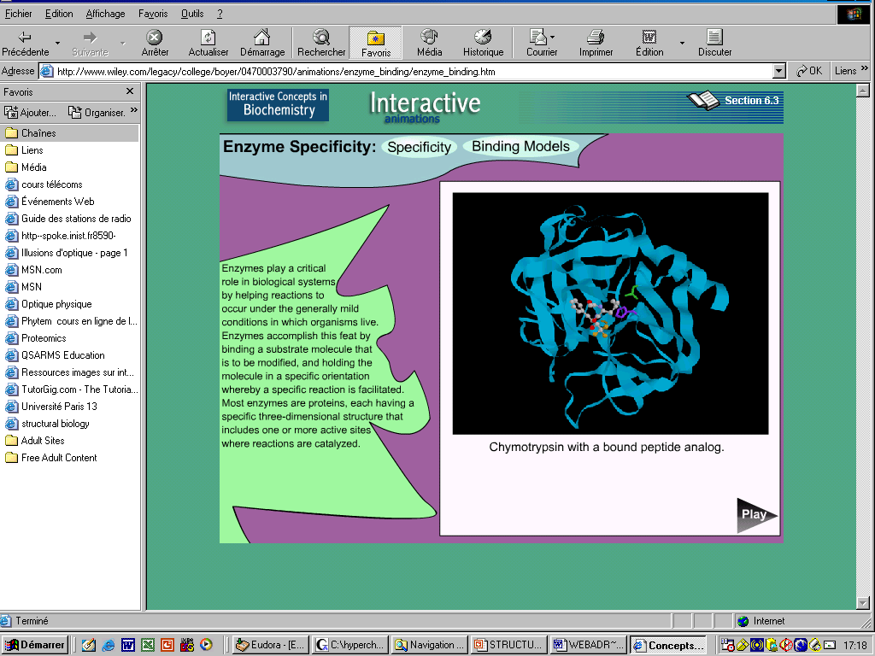
From spectroscopy to « Biomimetic Molecules » ?
Small molecules forming the elementary blocks of biomolecules: amino acids, small peptides, nucleic acids, sugars…
Can serve as validation tools
relatively small molecules are the favourite candidates for most oral drugs (so-called « Lipinsky rule »):
-molecular weight of 500 or less,
-not more than 5 hydrogen-bond donor sites,
-not more than 10 hydrogen-bond acceptor sites
Jorgensen, “Drug Discovery”, Science, 303, 1813 (2004)
Notes:
Researchers are convinced that knowledge of the properties of the elementary building blocks of life will lead to a better prediction of both the structure and the function of larger biomolecules. These building blocks include amino acids, peptides and peptide models, nucleobases, sugars, as well as their relevant complexes and clusters. These chemical entities are called here “biomimetic molecules”.

Slide 2
Gas phase studies
« Effectifs Hamiltonians »
opérateurs x paramètres :
Development in series
« Quantum chemistry », ab initio
Eq. Schrödinger (Born-Oppenheimer)
Interatomic distances, angles
.
Spectra analysis
Line positions and intensity fit
Spectroscopic parameters related to molecular structure :
rotation constants, Torsion potential function,
electric dipole moments, vibrational parameters …
NMR, X-ray, Raman,
IR condensed phase
Studies
Force field calculations
Biological processes in situ

Slide 3
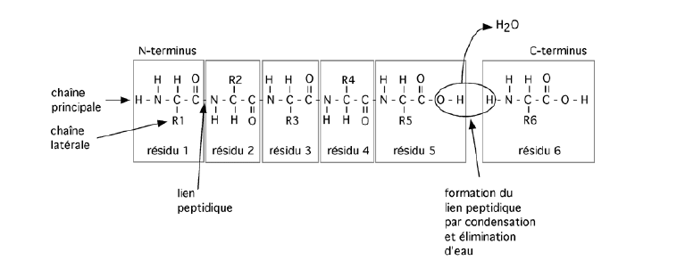
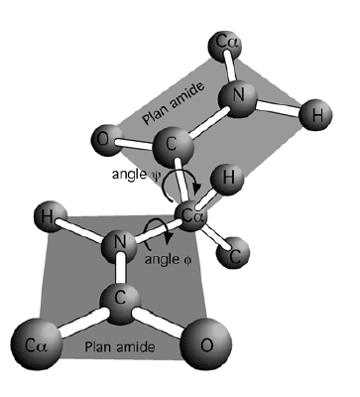
What systems ?
Proteins are formed by a reservoir of 20 amino acids. Amino acids are related by peptidic bondings to form polypeptides
Backbone chain
Side chain
Residue 1
Residue 2
Residue3
Peptide link: rigid, planar
Formation of peptide link by
condensation and elimination of
water
Only certain values of the Ramachadran angles
φ and Ψ are possible
Notes:
The PHI angle is the dihedral around the N-Calpha and PSI is the dihedral angle around the C-Calpha

Slide 4
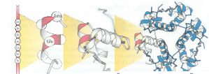
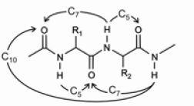
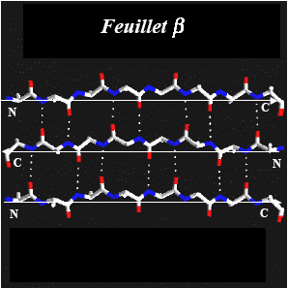
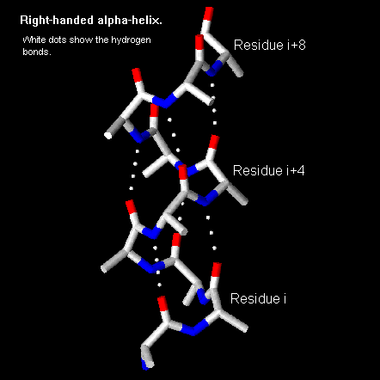
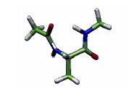
Hydrogen Bond
Primary structure Secondary Tertiary Quaternary
γ turns
β sheets
α helix
Notes:
Primary structiure: sequence of amino acids in the protein, Depending on the length of the chain and the residue, hydrogen bonding are universal in biology, they stabilize the secondary structures and guides the folding of the proteins. Hydrogen bonding can happen or not involving different number of atoms. Secondary structures : α ηελιξ , β sheets and gamma turns. Turns are important as they allow the polypetide chain to reverse direction Tertiary: folding of the seconday structure in space, quater: some proteins are formed from several polypetide chains

Slide 5
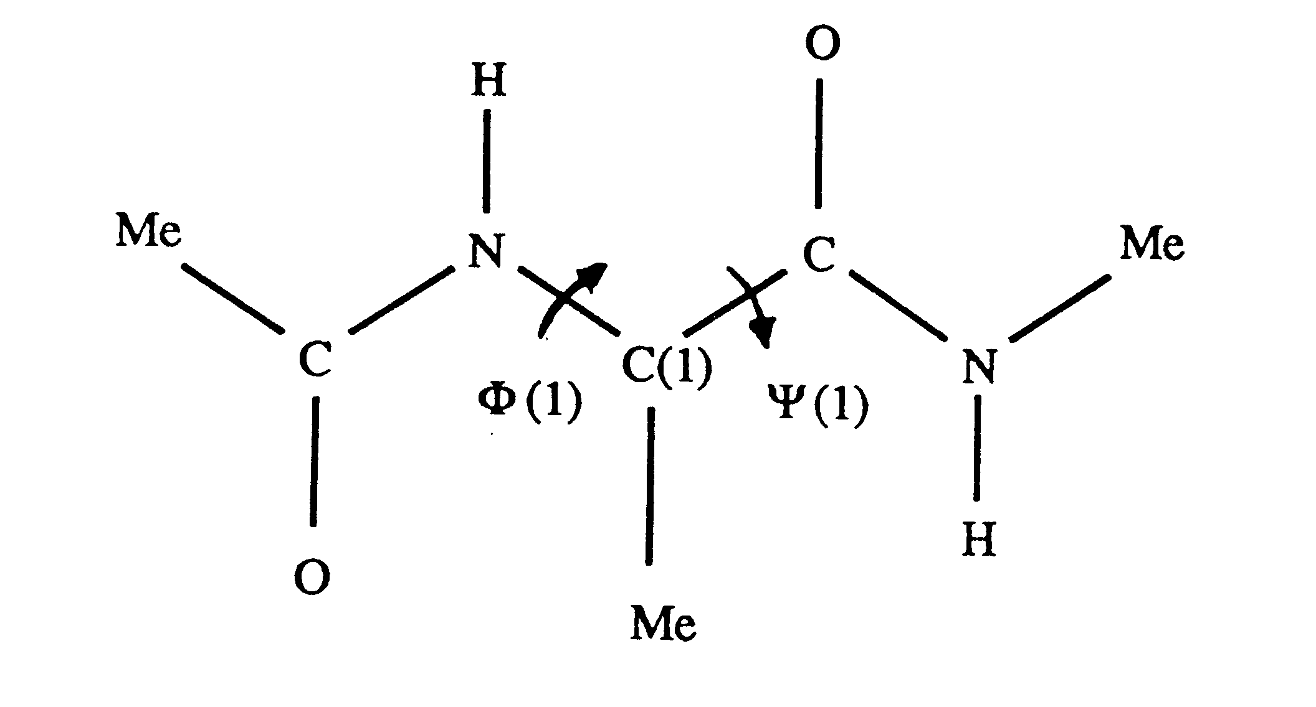
Hydrogen Bond & Torsion
Secondary and tertiary structure of proteins
How is Microwave spectroscopy at high resolution going to contribute ??? :
Internal rotation splittings can be used to obtain the structure/folding of molecules in gas phase WITHOUT doing isotopic substitution.
Lavrich et al. JCP 2003
Notes:
Hydrogen bonds : -universel in biologic systems,-stabilizes most of the secondary structures,-guides the folding of proteins
Polypeptide chains are formed by a chain of a-amino acids formed by elminiation of water
Ramachandran angles : 2 dihedral angles describing the relative positions of the 2 peptidic bonds

Slide 6
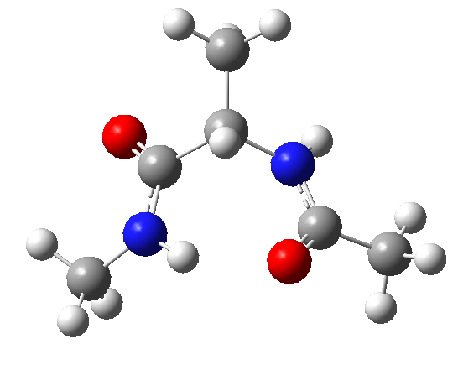
Dipeptide Mimetic: collaboration with NIST
Alanine Dipeptide : N-Acetyl Alanine Methyl Amide (AAMA)
Decomposition product
JB95, Lavrich et al. JCP 2003
V₃(1)=98 cm⁻¹, V₃(2)=81 cm⁻¹
JB95
V₃(1)=322 cm⁻¹
Ethyl Acetamidoacetate: EAA
N-Acetyl Alanine Methyl Ester Molecule (AAME)
JB95+BELGI ,2 lowest conformers
Lavrich et al, JCP 2003 V₃(1)= 70 cm⁻¹
JB95+BELGI: JCP 2006
V₃(1)=68 cm⁻¹, V₃(2)=407 cm⁻¹

Slide 7
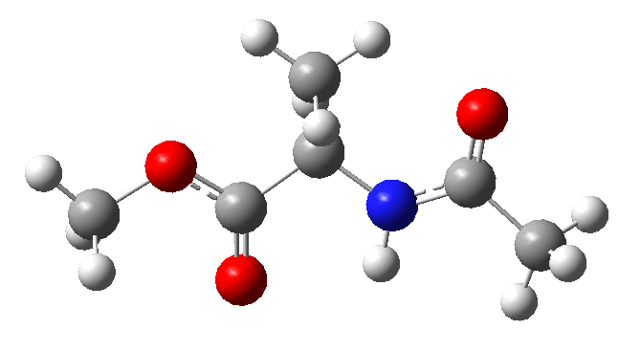
130 lines fitted
RMS= 1.8 kHz
14 parameters
V₃= 396.45(7)cm⁻¹
123 lines fitted
RMS= 2.5 kHz
17 parameters
V₃= 64.96(4) cm⁻¹
The Microwave Spectrum of a Two-top Peptide Mimetic: N-Acetyl Alanine Methyl Ester Molecule (AAME), Plusquellic, Kleiner J. Chem. Phys. 125, 104312 (2006)

Slide 8
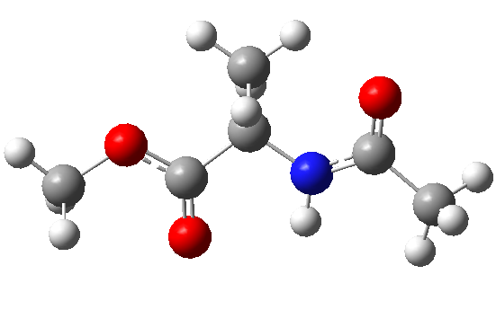
Conformational searches, Structure and hydrogen bond
13 stable conformers of ADME located, full geometry optimisations with B3LYP/6-31G(d) et G3MP2B3
Comparison of ab initio structure for AAMA (alanine dipeptide) et ADME (N-acetyl alanine methyl ester)
AAMA
ADME
φ
ψ
C₅
C₇
Ramachandran angles
Ψ ≅75° φ ≅-82°
Similar to a γ-turn structure
Ramachandran angles
Ψ ≅171° φ ≅-159°
Similar to a β-sheet structure
Notes:
Replacement of the NH-CH3 group with the methyl ester group O-CH3 removes the proton donor group of AAMA eliminating the intramolecular hydrogen bond of C7.

Slide 9
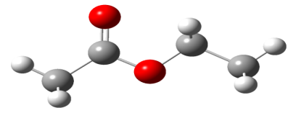
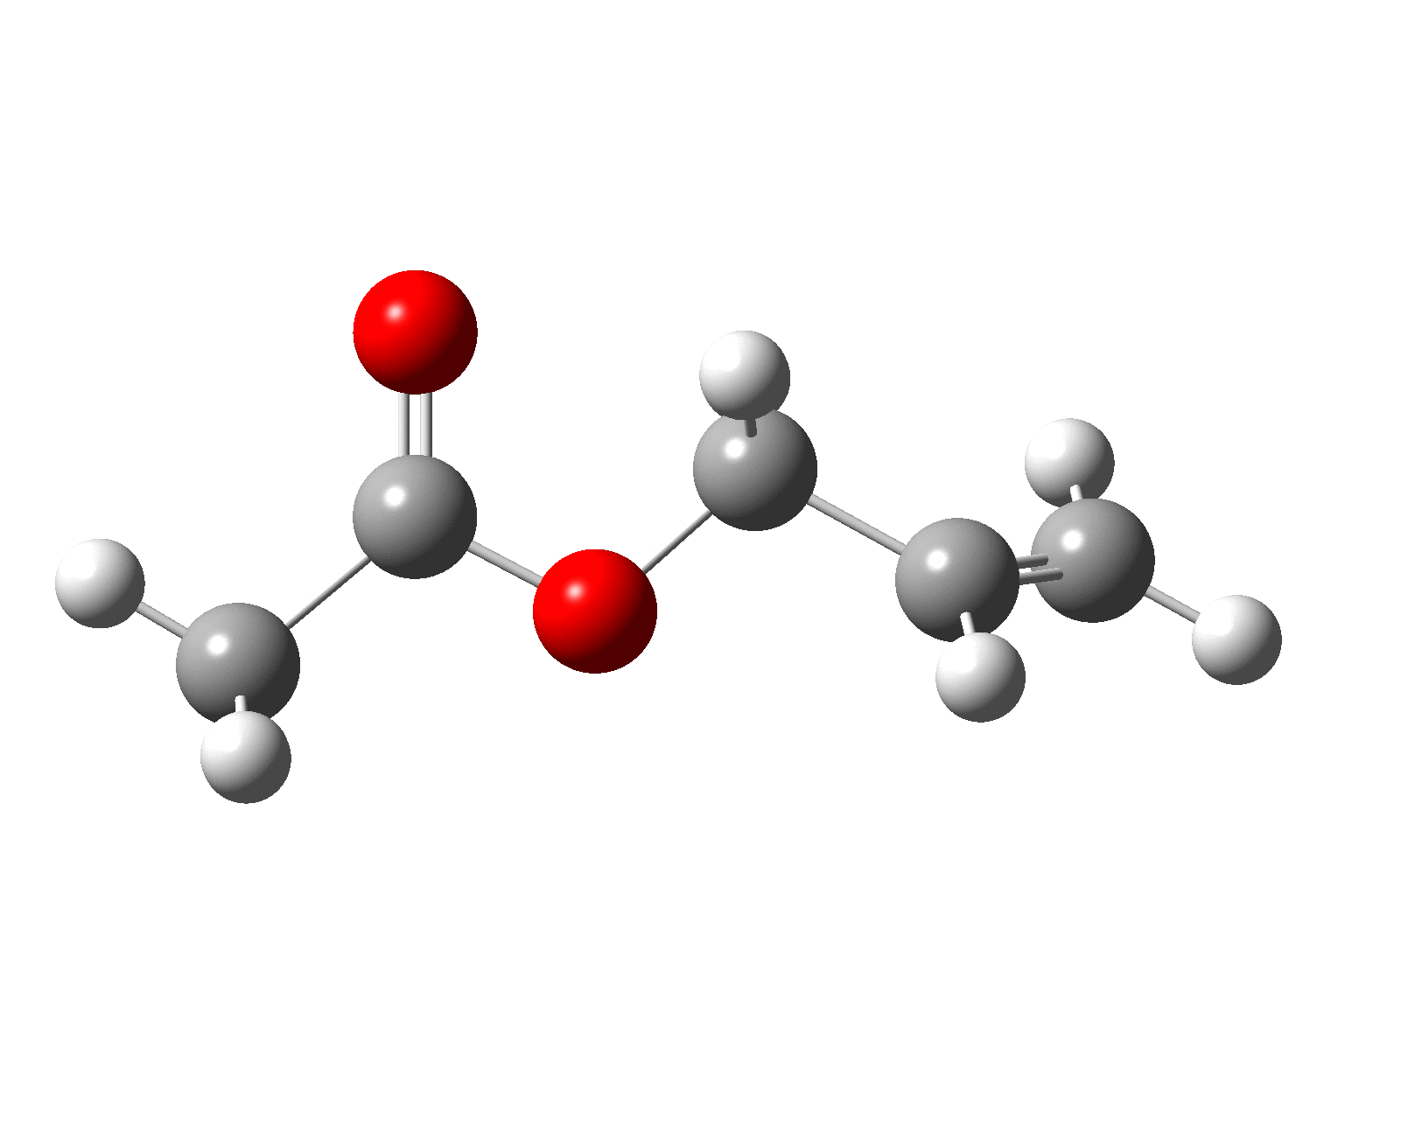
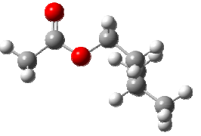
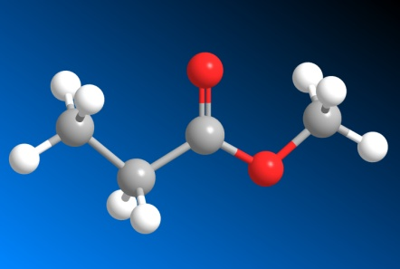
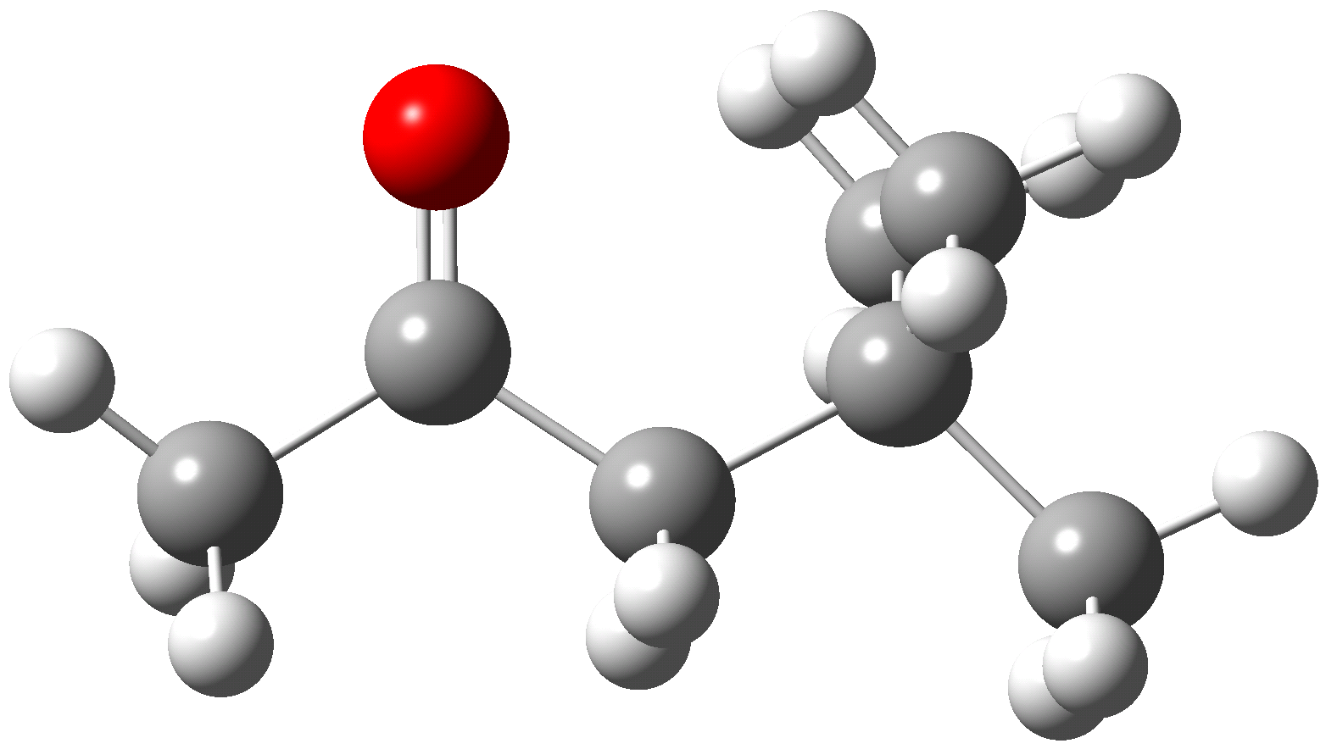
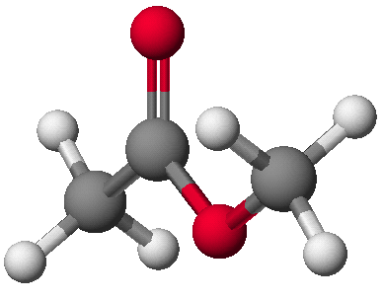
Internal rotation and structure of esters
Collaboration with Institute of Physical Chemistry, RWTH Aachen (Germany):
W. Stahl, L. Nguyen, H. Mouhib, T. Attig, Y. Zhao, D. Jelisavac, L. Sutikdja, R. Kannengisser
Ethyl acetate
Allyl acetate
Isoamyl acetate
Methyl propionate
JMS 2009
100 cm⁻¹
1000 cm⁻¹
100 cm⁻¹
Mol Phys 2010
Mol. Phys 2012
Methyl
Neopentyl ketone
Mol. Phys 2012
Methyl acetate
JMS 2012
JMS 2011
Esters (or cetones) of large size not much studied by microwave spectroscopy
- Too many atoms to determine their structure by isotopic substitution
- Large internal rotation splittings, serve as test of our models
- Determination of the structure of the most stable(s) conformer(s)

Slide 10
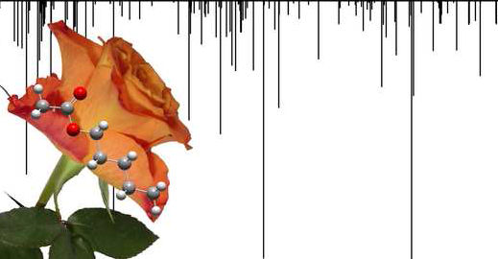
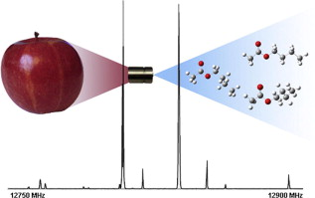
  Conformational analysis of n-pentyl acetate using microwave spectroscopy
  J. Mol. Spectrosc., 290, 2013, 24-30
  T. Attig, R. Kannengießer, I. Kleiner, W. Stahl
  The microwave spectrum of n-butyl acetate
  J. Mol. Spectrosc. 284–285, 2013, 8-15
  T. Attig, L.W. Sutikdja, R. Kannengießer, I. Kleiner, W. Stahl
Structural studies on banana oil, isoamyl acetate,
by means of microwave spectroscopy and quantum
chemical calculations
L.W. Sutikdja, D. Jelisavac, W. Stahl and I. Kleiner
Mol. Phys 110, 2883–2893 (2012)

Slide 11
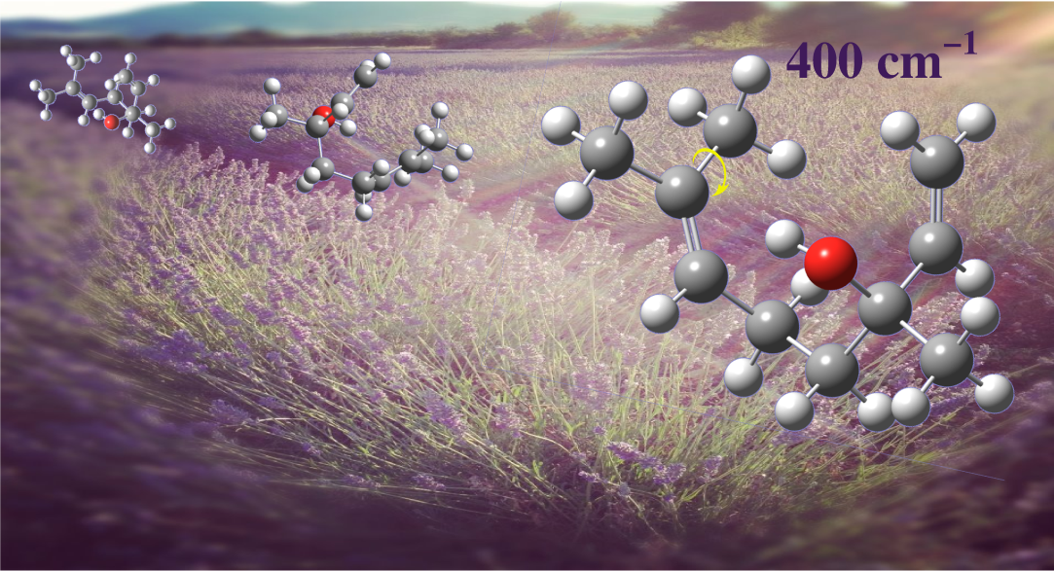
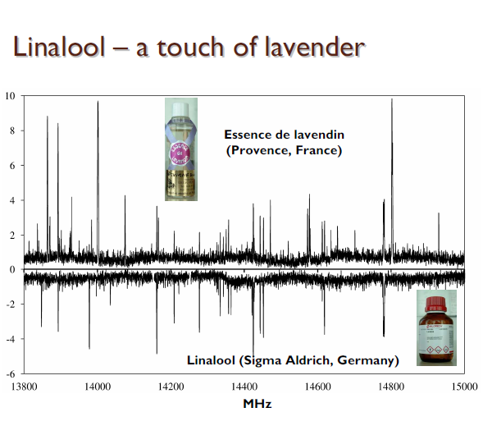
Nguyen, Kleiner et al Phys.Chem. Chem. Phys., 15, 10012 (2013)

