Slide 1
What is internal rotation ?
The methyl group can turn relatively to the rest of the molecule and this large amplitude motion is hindered
by a three-fold potential barrier. Quantum energy levels are split by a tunneling effect into A and E levels

Slide 2
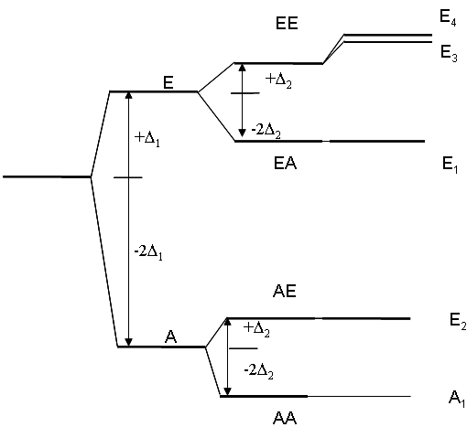
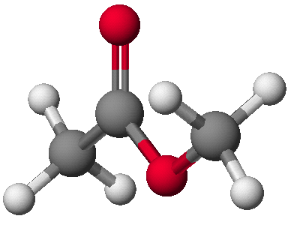
Methyl acetate: 2 non equivalent methyl tops
JK_{a}K_{c}
3 sets of torsional splittings:
  (AA,EA). V₃ = 100 cm⁻¹
  Δ₁ = 2 cm⁻¹
  (AA,AE). V₃ = 400 cm⁻¹
  Δ₂ = 0.01 cm⁻¹
  (AA,EE). Interaction between the 2 tops
Tudorie, Hougen, Kleiner et al, JMS,
269, 211-225 (2011)
Ohashi, et al JMS, 227 28-42 (2004)
Notes:
2
We treat the two top problem as like we had two independant tops and fit each of their splittings separately

Slide 3
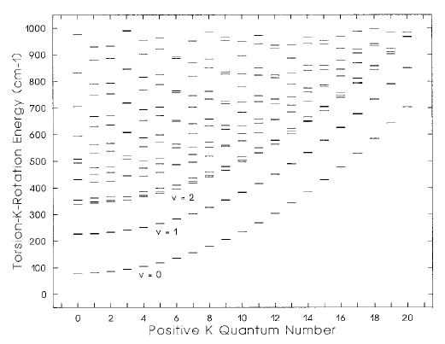
Acetaldehyde CH₃CHO rotation-torsion energy levels MAPS
v₁₀ = 1
V₃ = 400 cm⁻¹
Moazzen-Ahmadi, Kleiner et al J. Mol. Spectrosc. 252, 214-229
(2008)
BELOW THE BARRIER E_{ROT-torsion}= [A-(B+C)/2]K² + Torsional residual energy
A, B, C : rotational constants. K: projection of the rotational angular momentum J on the symetry axis of the molecule

Slide 4
Theoretical Model: the global approach
RAM = Rho Axis Method (axis system) for a C_{s} (plane) frame
H_{RAM} = H_{rot} + H_{tor} + H_{int} + H_{d.c.}
Torsional operators and potential function V(α)
Constants | 1 | 1-cos3α | p²_{α} | J_{a}p_{α} | 1-cos6α | p⁴_{α} | J_{a}p³_{α}
1 |  | V₃/2 | F | ρ | V₆/2 | k₄ | k₃
J² | (B+C)/2* | F_{v} | G_{v} | L_{v} | N_{v} | M_{v} | k_{3J}
J_{a}² | A-(B+C)/2* | k₅ | k₂ | k₁ | K₂ | K₁ | k_{3K}
J_{b}² - J_{c}² | (B-C)/2* | c₂ | c₁ | c₄ | c₁₁ | c₃ | c₁₂
J_{a}J_{b}+J_{b}J_{a} | D_{ab} or E_{ab} | d_{ab} | Δ_{ab} | δ_{ab} | d_{ab6} | ΔΔ_{ab} | δδ_{ab}
Rotational Operators
Kirtman et al 1962
Lees and Baker, 1968
Herbst et al 1986
= angle of torsion, ρ = couples internal rotation and global rotation, ratio of the moment of inertia of the top and the moment of inertia of the whole molecule
Hougen, Kleiner, Godefroid JMS 1994
Kleiner JMS 2010, Kleiner et al JCP 2003
Notes:
Rotational constants give the structure.
Using the diagonalization of the inertial tensor, one can get the orientation angles of the CH3 group relative to the PAS

Slide 5
Existing Internal Rotation Programs: see PROSPE (Programs for ROtational SPEctroscopy)
http://www.ifpan.edu.pl/~kisiel/prospe.htm , Z. Kisiel (Poland)
Name authors what it does? Method
_______________________________________________________________________
XIAM Hartwig up to 3 sym tops RAM-PAM (« Woods » method)
Maeder up to one quad Effective or local fit of v_{t} states
(Germany) nucleus A-E often fit separately
_______________________________________________________________________
ERHAM Groner one and two RAM-PAM, Fourier series (USA) internal rotors Effective or local fit of vt states
of sym.C_{3v} or C_{2v} A-E fit together
acetone, DiMether, MeCarbamate, MeFormate
________________________________________________________________________
BELGI Kleiner one or two C₃v internal RAM method
Godefroid, rotor Global fit of v_{t} states
Hougen A and E species fit together
Xu, Ortigoso,
Ilyushin, acetaldehyde, acetic acid, acetamide,MethylFormate, Carvajal Mecarbamate,alanine dipetide…
________________________________________________________________________

Slide 6
________________________________________________________________________
Japan Nakagawa methanol-like molecule RAM global
Tsunekawa
(Toyama)
1985
methanol, methyl mercaptan, methyl formate
_____________________________________________________________________
Ukraine RAM36 code one-top 6 fold, 3 fold RAM global approach
Ilyushin same as BELGI
very fast
toluene, methyl formate, acetaldehyde 13C

