Slide 1
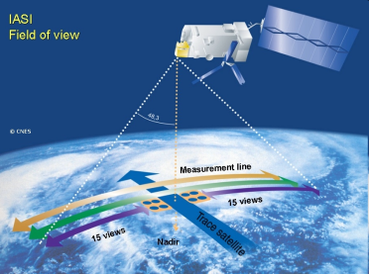
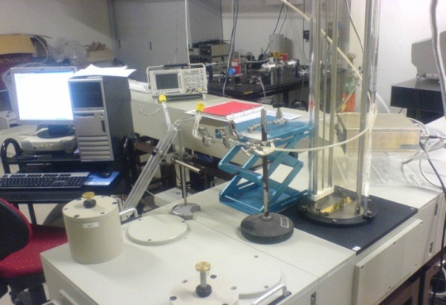
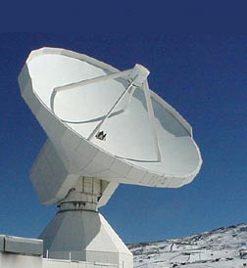

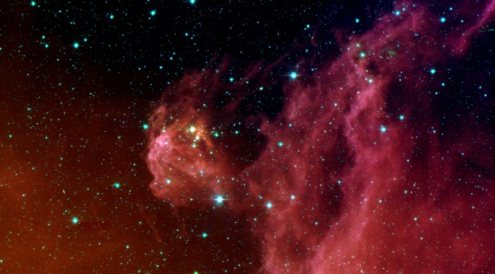
Spectres de
laboratoire
Spectres
Atmosphériques
ou astrophysiques
+
Données spectroscopiques
Modèle théorique
Analyse des spectres
Positions
Intensités
Profils de raies
Méthode d’analyse
Modèle de chimie, pollution
HΨ = EΨ

Slide 2
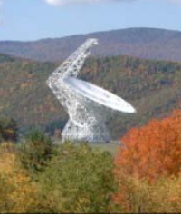
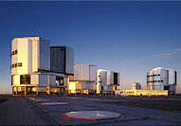
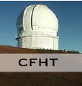
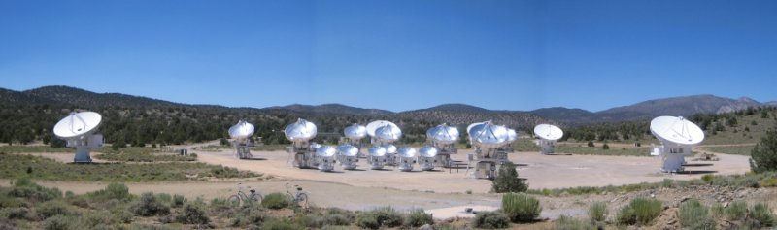
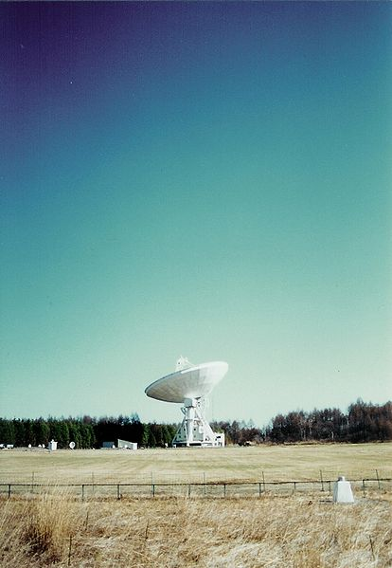
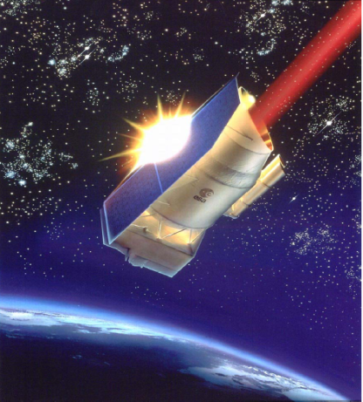
From Molecular spectroscopy to astrophysics
Coverage of the whole electromagnetic spectrum
IRAM: Spain
GBT: USA
ESO-VLT: Chili
Very Large Telescope
Near UV-25μm
Green Bank Telescope
100m, 1.4 , 24, 90, 115 GHz
1 Antenna of 30m
67-116, 130-183,
194 266 241-282 Ghz ,
Canadian
French Hawai Telescope
CARMA: USA
Nobeyama Japan
IRAM: France
Infrared
Space
Laboratory
1995-98
SWS-LWS:
2.5-240 μm
Combined Array for
Research in Millimeter-
wave Astronomy
23 antenna, 27-35, 85-116,
215-270 GHz
1 antenna of 45m
20-230 GHz

Slide 3
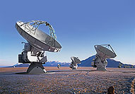
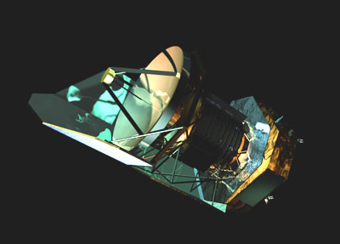
Recent observatories!
  ALMA: The Atacama Large Millimeter/submillimeter Array: 2012
400μm to 3mm (84 to 720 GHz):
84-116, 211-275, 275-370, 602-720 GHz
64 antenna of 12m (extended on 18.5km)
High Sensitivity, high spatial resolution,
spectral resolution: a few MHz- kHz
  Herschel/HIFI: heterodyne spectrometer for the FIR: april 2009-2012
480-1250 GHz , 1410-1910 GHz:
High spectral resolution < 1 MHz
Notes:
ALMA will operate at wavelengths of 0.3 to 9.6 mm. At these wavelengths, a high, dry site is needed for the telescope to be able to see through the Earth’s atmosphere. This is why ALMA is being built on the 5000 m high plateau of Chajnantor in the Atacama region of Chile. ALMA will offer unprecedented sensitivity and resolution. The 12-meter antennas will have reconfigurable baselines ranging from 15 m to 16 km. Resolutions as fine as 0.005 arcseconds will be achieved at the shortest wavelengths – a factor of ten better than the Hubble Space Telescope. With such a high resolution, it is possible to recognize a coin left on the street in Osaka from Tokyo . 0.01 arcsec at maximum ; can see any object of 40 km in the distance between Jupiter and Earth, 1.4 arcsec -0.02 arcsec, 1arcsec=1/3600 degrees
Km/sec: vitesse de la source emettrice (par effet Doppler)

Slide 4
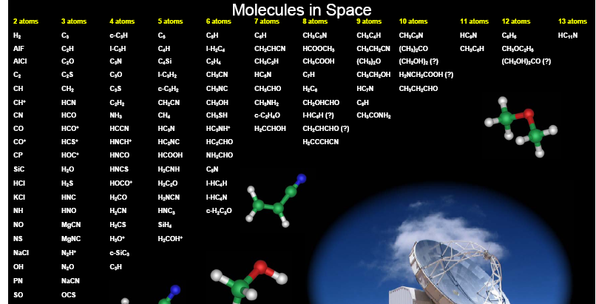
Molecules in the Interstellar Medium or Circumstellar Shells : 02/2009
CDMS : Cologne Data base http://www.astro.uni-koeln.de/site/vorhersagen/molecules
ABOUT 150 MOLECULES
MANY WERE DETECTED
THANKS LABORATORY
WORK!

Slide 5
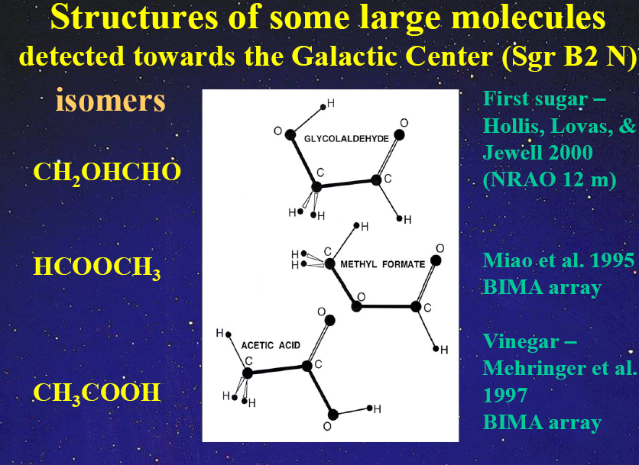
Sgr B2(N) relative abundances of
(acetic acid) : (glycolaldehyde) : (methyl formate) 1 : 4 : 26,
consistent with the observed preference for C-O-C backbone structures
in complex interstellar molecules.
BUT Remijan et al found a ratio CH₃COOH/HCOOCH₃ 3.3 × 10⁻²

Slide 6
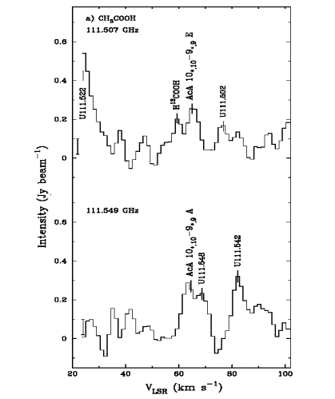
ACETIC ACID CH₃COOH : a much lower barrier case
Barrier Heigth V₃ = 160 cm^{-1,} s = 4V₃/9F = 13
Ilyushin (Kharkov), Lovas, Hougen (NIST, USA), Demaison
(Lille): Fit of about 3800 lines up to J = 30
J. Mol. Spectrosc. 205, 286-303 (2001)
J. Mol. Spectrosc., 220, 170-186 (2003)
Atlas of lines up to 400 GHz, JPCRD (2008)
-isomer of HCOOCH₃ et de CH₂OHCHO
-involved in the glycine synthesis in the lab
First detection of acetic acid in Sgr B2:
Mehringer et al 1997 (4 lines detected)
in the comets : Crovisier et al 2001
Observed Spectrum of Sgr B2 , hot cores
Remijan et al., ApJ, 576, 264-273, (2002)

Slide 7
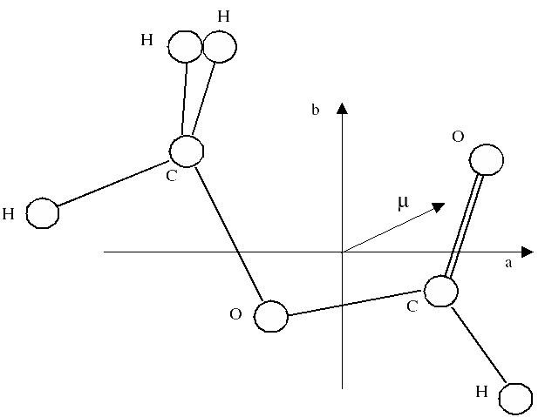
HCOOCH₃ and isotopologues
¹²HCOO¹²CH₃:
-About 900 lines from v_{t} = 0 detected in hot cores (Orion KL, Sgr B2(N), W51 e1/e2), low-mass-star-forming regions, comets.
About 80 detected in v_{t} = 1 (Demyk et al A&A, 2008, Kobayashi et al Ap. J., 657, L17 (2007)).
v_{t} = 2 torsional state, Kobayashi et al

Slide 8
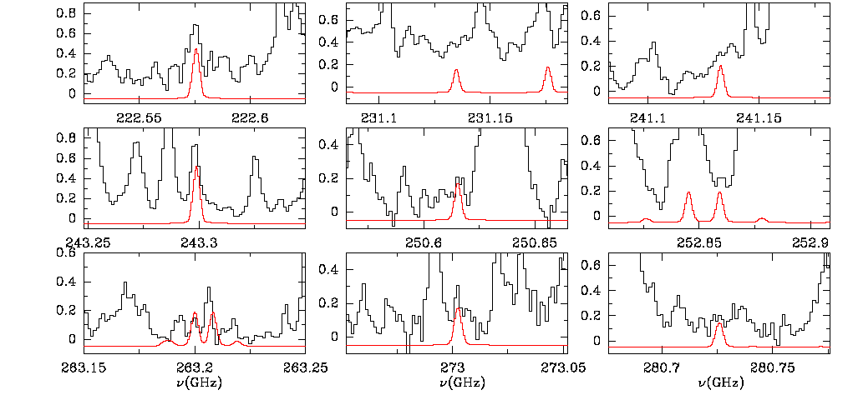
Internal rotation of astrophysical molecules : microwave, (sub)-millimeter spectra of isotopic species of methyl formate
L. Margulès, Th Huet, J. Demaison, R. Motyenko, (Lille) and M. Carvajal, Huelva
Astrophysical detection: J. Cernicharo (madrid)
HCOOCH₃, H¹³COOCH₃,
HCOO¹³CH₃, DCOOCH₃,
HC¹⁸OOCH₃, HCO¹⁸OCH₃
Astrophysical interest
(ALMA, Herschel)
MF formation from
H₂CO and CH3OH
to get rid of unidentified lines
in the surveys
To determine isotopic
ratios
Our prediction has allowed the
first detection of 460 lines
13C1 and 13C2 methyl formate in
Orion !
Carvajal, Kleiner et al A&A 2009

Slide 9
ACETAMIDE
V₃ = 25 cm⁻¹
Hyperfine (¹⁴N) and internal rotation
splittings
First detection of acetalide in the star forming region of SgrB2 with the 100m Green Bank telescope (GBT)
“Detection of Acetamide (CH₃CONH₂): The largest Interstellar Molecule with a Peptide Bond”, J. M. HOLLIS, F. J. LOVAS, A. J. REMIJAN, P. R. JEWELL,
V. V. ILYUSHYN and I. KLEINER Ap. J., 643, L25-L28 (2006).
Yamaguchi, Hagiwara, Odashima, Takagi, and Tsunekawa, J. Mol. Spectrosc. 215, 144 (2002)
Suenram, Kleiner et al J. Mol. Spectrosc. , 208, 188 (2001),
Ilyushin, Kleiner et al J. Mol. Spectrosc., 227, 115 (2004).

Slide 10
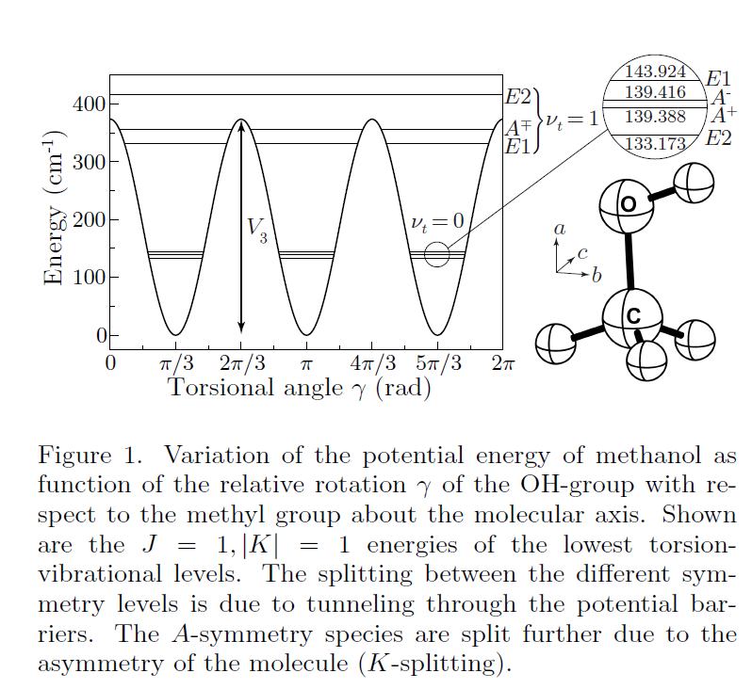
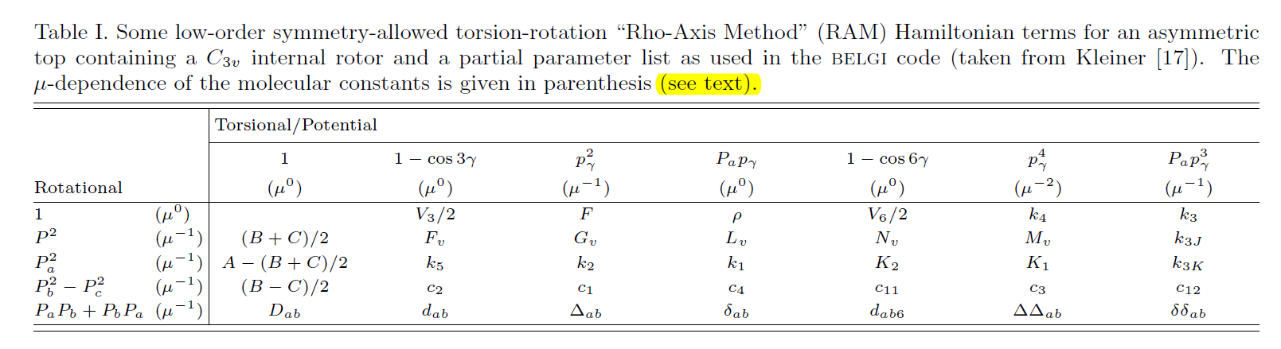
Methanol as a sensitive probe for spatial and temporal variations of the
proton-to-electron mass ratio
Paul Jansen, Li-Hong Xu, Isabelle Kleiner, Wim Ubachs, and Hendrick L. Bethlem
Phys. Rev. Lett. 106, 100801 (2011).
Sensitivity of Transitions in Internal Rotor Molecules to a Possible Variation of the
Proton-to-Electron Mass Ratio
Jansen, Kleiner, Xu, Ubachs, Bethlem
Phys. Rev. A 84, 062505 (2011)
The sensitivities of other transitions in the different sotopologues of methanol range from-88 to 330. This makes methanol a sensitive probe for spatial and temporal variations of the proton-to-electron mass ratio.

Slide 11
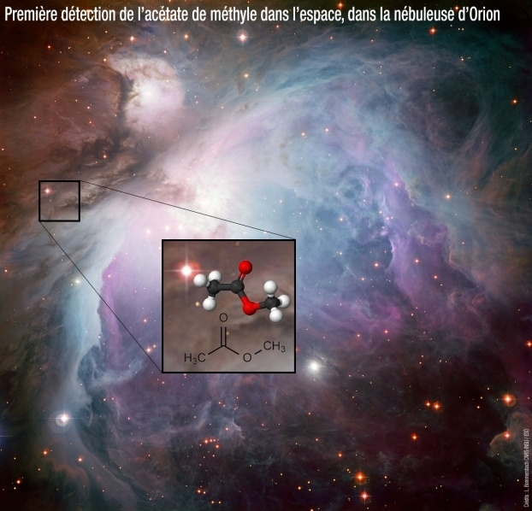
Microwave (sub)mm spectroscopy of astrophysical molecules containing two internal rotation methyl groups (-CH₃)
First detection (2013) of METHYL ACETATE in the interstellar cloud Orion thanks intensive spectroscopic laboratory studies !
In black: Observed spectrum of Orion with the IRAM telescope
In green: model of Orion including100 molecules (most abundant),
In red:methyl acetate line prediction for methyl acetate from our spectroscopic work
Tercero, Kleiner, Cernicharo et al., Ap.J, (2013)
Tudorie, Kleiner et al JMS (2011)
Newly written code
Notes:
Traces en noir: Spectre observé à l'aide du télescope de l'IRAM
Traces en vert: modèle d'Orion incluant 100 molécules (les plus abondantes),
Traces en rouge: prédiction des fréquences et intensités pour l'acétate de méthyle.
11

