Slide 1

Aérosols, nuages et rayonnement en Afrique australe: questions ouvertes et nouvelles observations depuis des sites instrumentés au sol en Namibie
Paola Formenti
Laboratoire Interuniversitaire des Systèmes Atmosphériques, Créteil
Henties Bay, Namibia – Avril 2015

Slide 2
Plan de la présentation
Motivation & état de l’art
Activités en cours & prévues

Slide 3
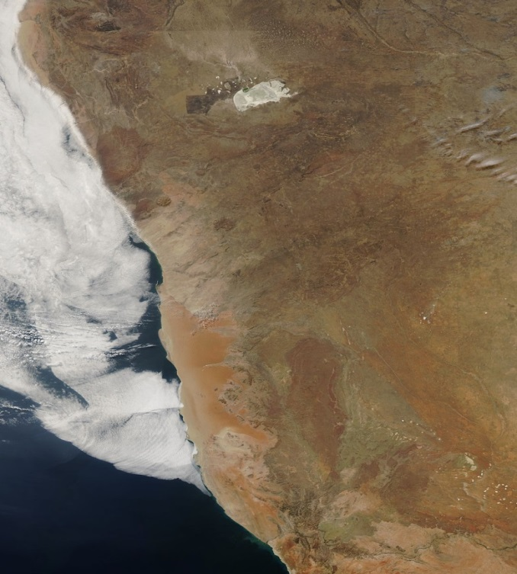
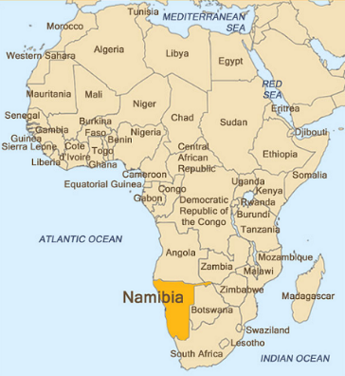
Marine Stratocumulus (Sc)
Nuages de couche limite étendues & semi-permanentes
  Associées avec la subsidence anti-cyclonique, basses SST’s; relativement uniformes, nuages basses (sommet <~1 km), forte inversion au sommet
Importants du point de vue climatique (refroidissement)
Le Sc au large de la Namibie ont été peu étudiés
  effet indirect (DMS → CCN → nuages)
  impact sur l’écosystème marin & sur l’écosystème du désert du Namib
  Surface plane ideale pour les études par télédétéction depuis les avions ou l’espace

Slide 4
Biais positif en SST au dessus de la plus part des régions du globe affectées par les stratocu (exerciceCMIP5)
“Pauvre” representation des stratocumulus dans les GCMs mais
Quel est l’impact des aerosols sur les propriétés physiques et optiques (LWP, albedo) de ces nuages?

Slide 5
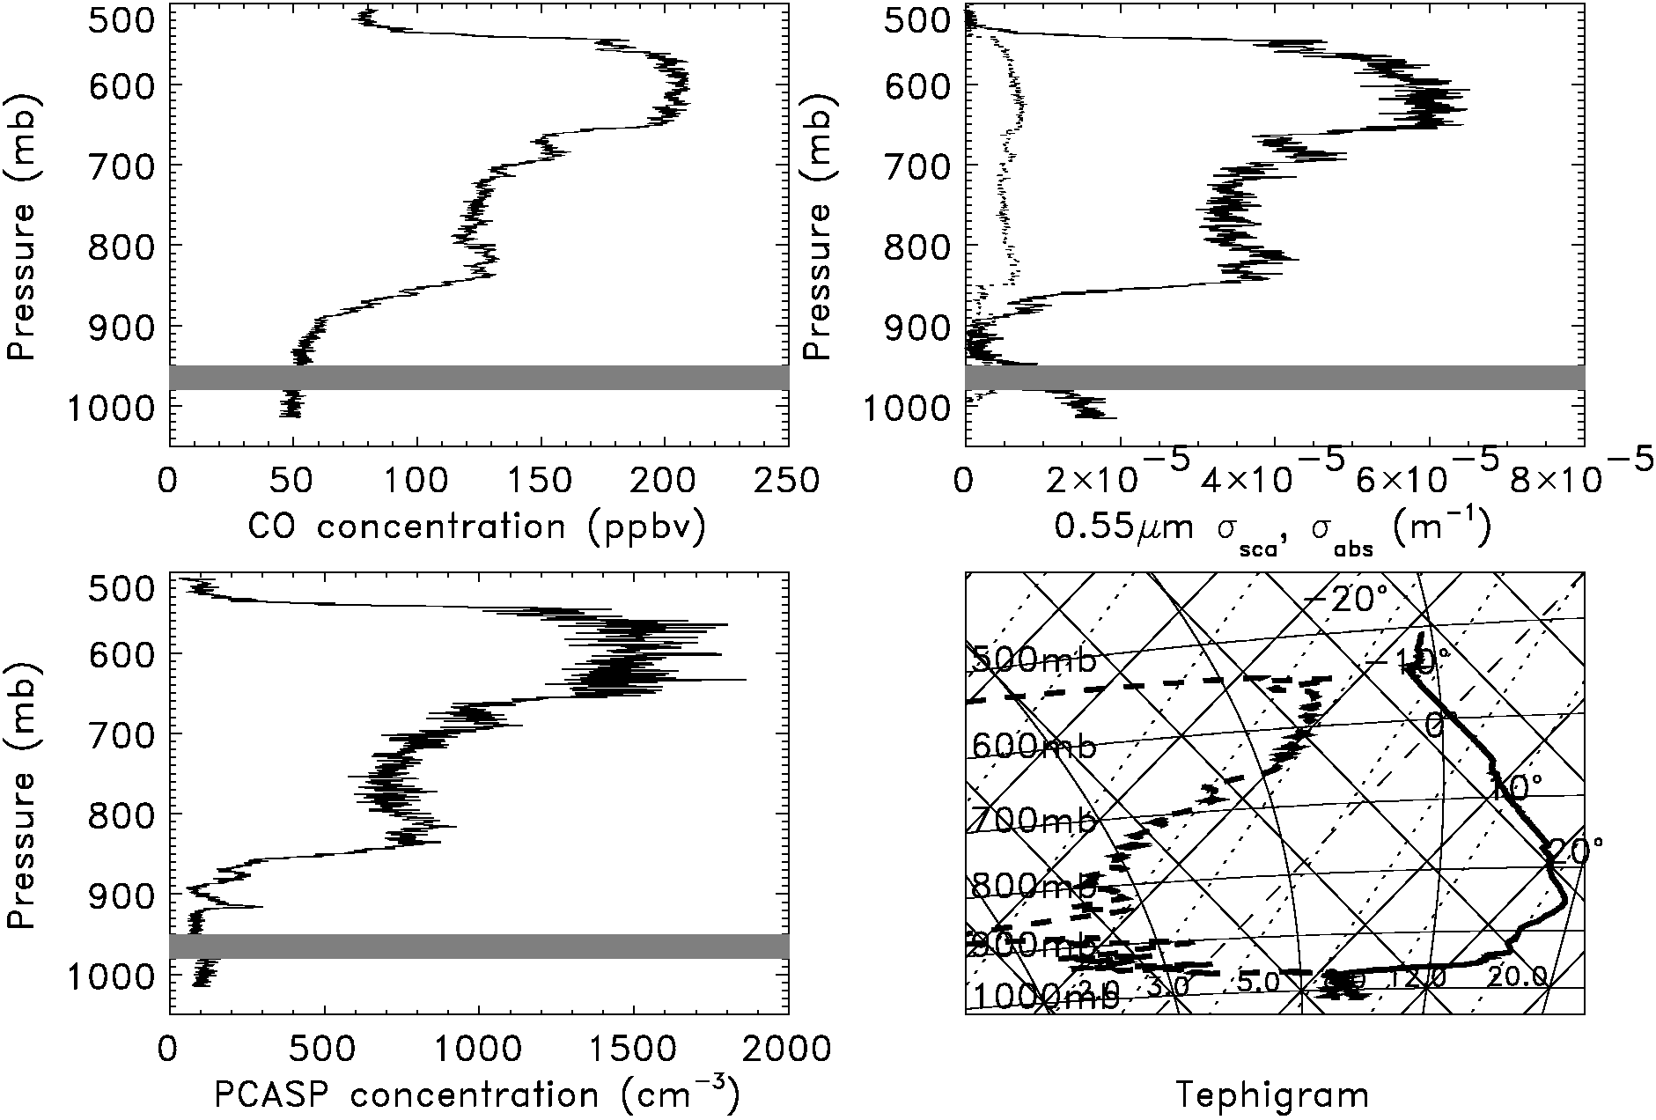
Couche d’aérosol issus de feux de biomasse au dessus des stratoCu
SAFARI 2000
Aged regional haze
Clear slot
Sc cloud
Sc cloud
Temperature inversion > 12 K
Sc cloud
Haywood et al. (2003)
Notes:
Over ocean the aerosol existed at high altitudes and was generally above the stratocumulus.
We will answer the questions:-
What is the effect of the vertical profile of aerosol/cloud on the overall direct radiative effect.
What is the effect of the aerosol above cloud on the derived cloud optical depth and the cloud effective radius.

Slide 6
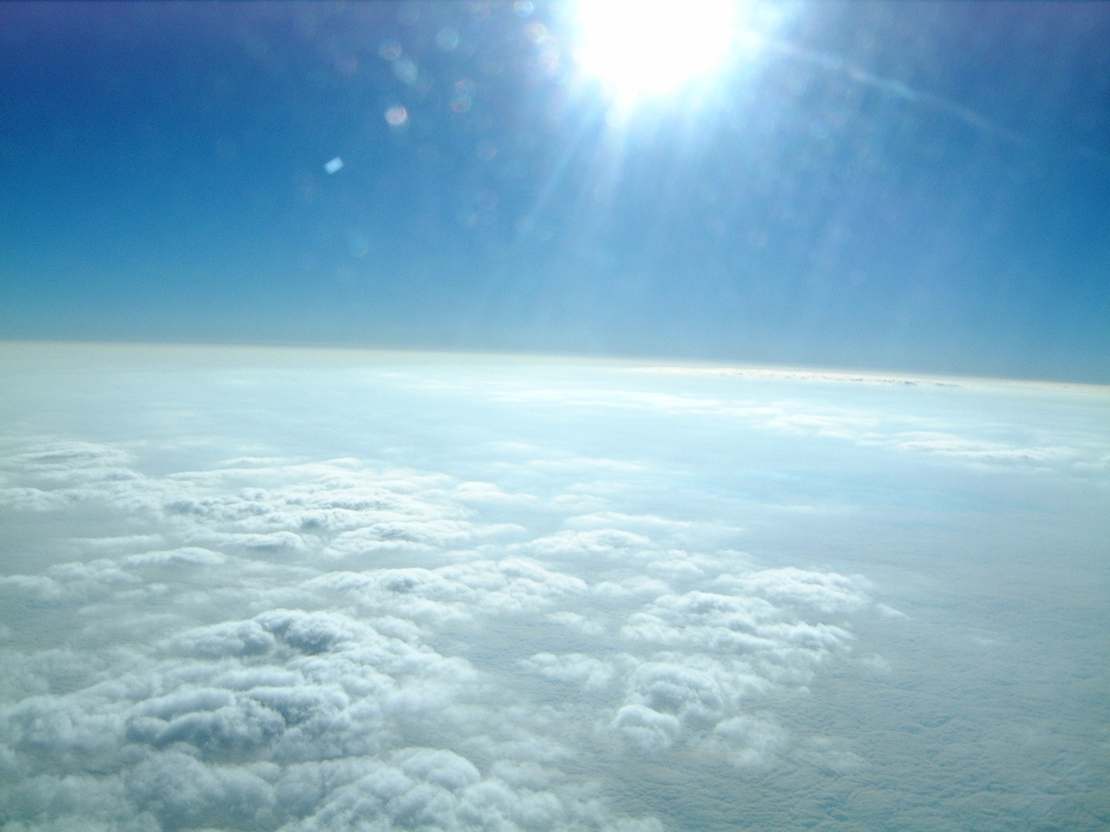
Mid-level Cu above the aerosol layer is much brighter.
Biomass burning aerosol makes low Sc cloud appear brown
Observations du C-130 Britannique pendant le transit Ascension-Windhoek (SAFARI2000)

Slide 7
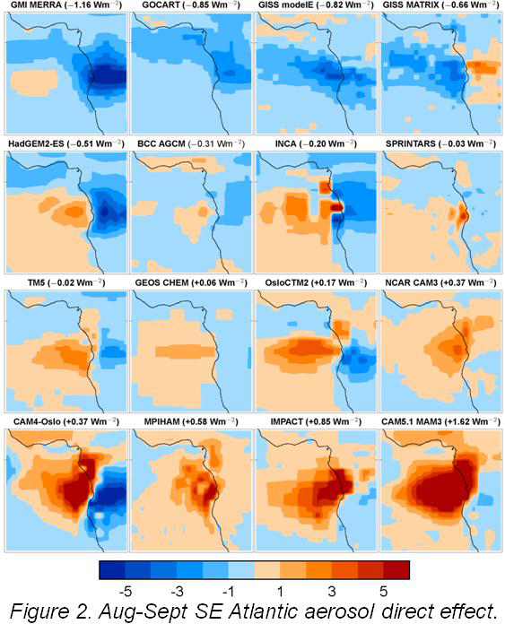
Forçage radiatif très significatif
Large gamme de variabilité (negatif→positif)
Où sont les incertitudes?
AEROCOM (Myhre et al., 2013)

Slide 8
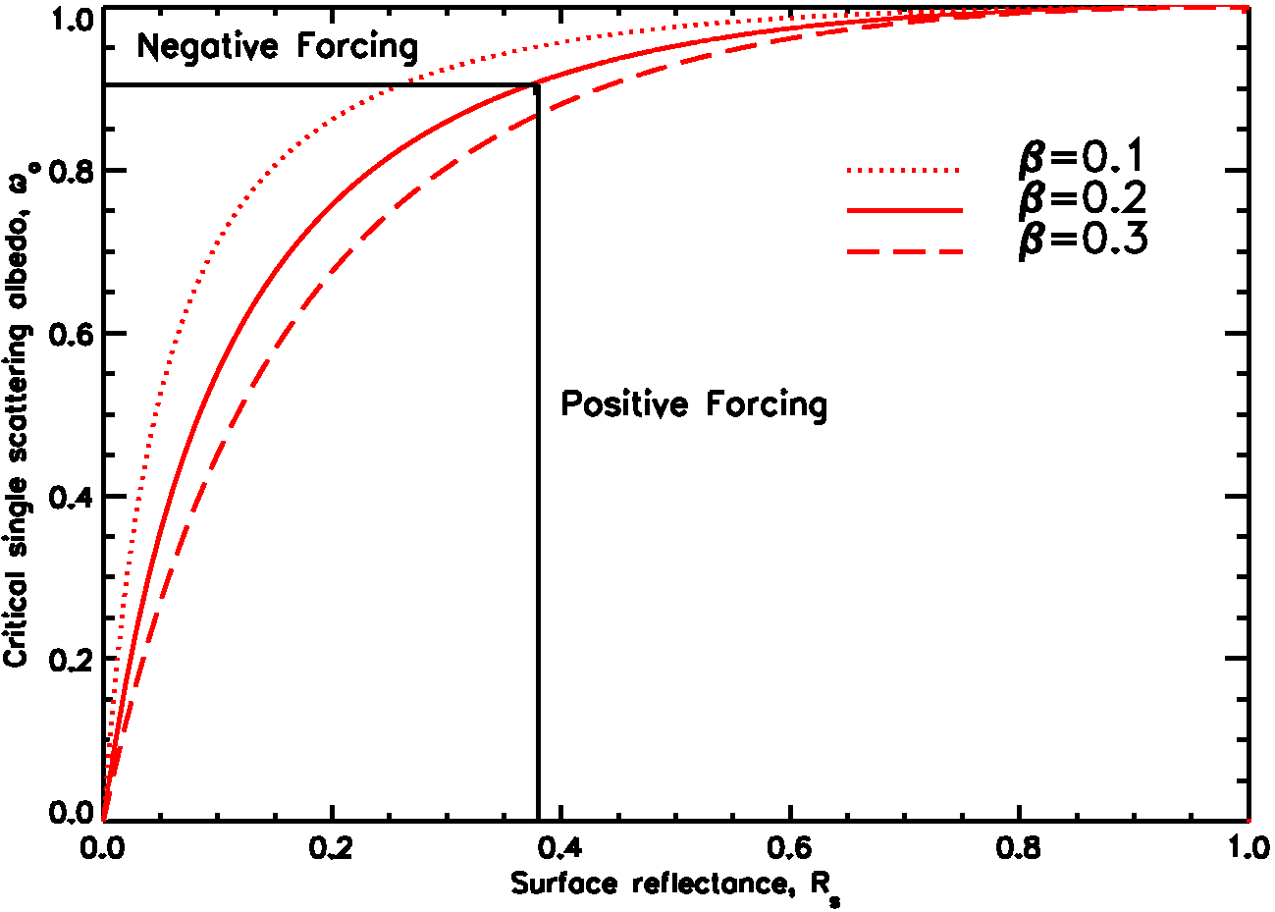
1. Les propriétés optiques d’absorption des aérosols, et leur taille
Feux, poussières
Taille
croissante
Océan
Déserts
Nuages
Neige

Slide 9
2. Effet radiatif direct d’aérosols absorbants devient positif quand ils se trouvent au dessus des nuages
1
2
3
Adapté de Liao and Seinfeld (1998)

Slide 10
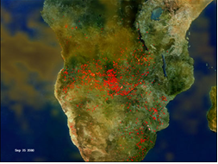
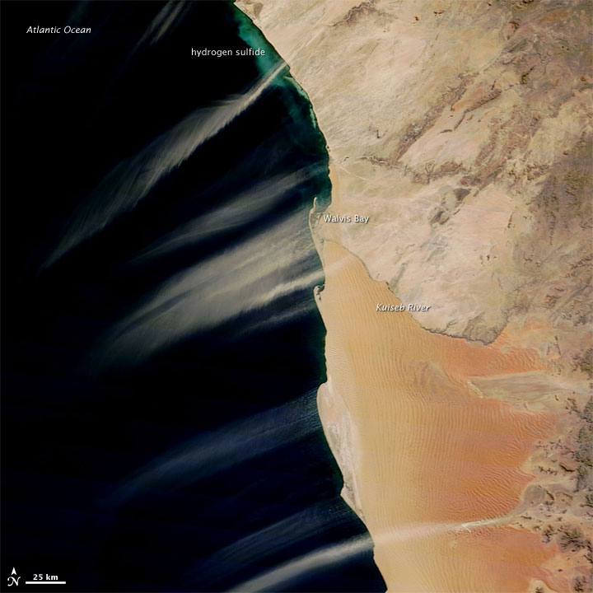
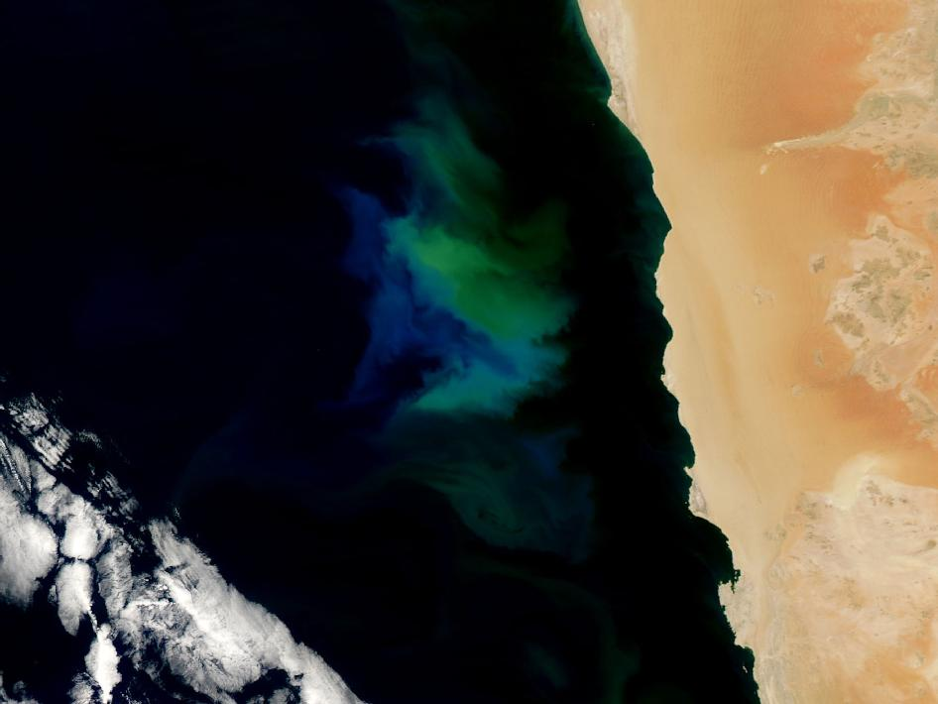
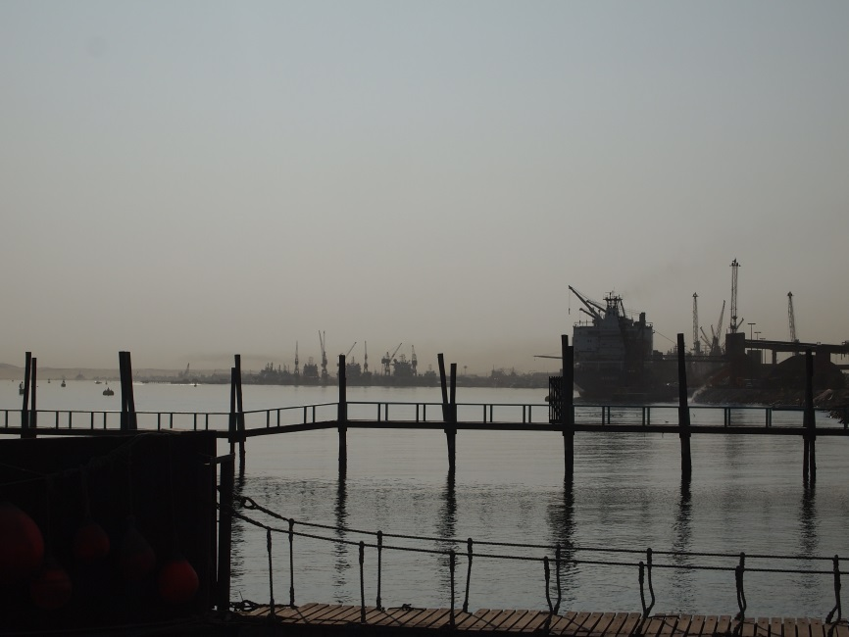
Feux de biomasse
Poussières
Organique/inorganique
Light-absorbing (mostly SW)
Bon CCN
Juin-Septembre
Inorganique
Light-absorbing (SW/LW)
Giant CCN
Toute l’année
Aérosol « marin »
Pollution
Organique/inorganique
Plutôt diffusants
Bon CCN
Toute l’année
Organique/inorganique
Light-absorbing (SW)
Bon CCN
Toute l’année

Slide 11
Feux de biomasse
Poussières
SAFARI-2000
Organique/inorganique
Light-absorbing (mostly SW)
Bon CCN
Juin-Septembre
Inorganique
Light-absorbing (SW/LW)
Giant CCN
Toute l’année
Aérosol « marin »
Pollution
Organique/inorganique
Plutôt diffusants
Bon CCN
Toute l’année
Organique/inorganique
Light-absorbing (SW)
Bon CCN
Toute l’année

Slide 12
Feux de biomasse
Poussières
?
SAFARI-2000
Organique/inorganique
Light-absorbing (mostly SW)
Bon CCN
Juin-Septembre
Inorganique
Light-absorbing (SW/LW)
Giant CCN
Toute l’année
?
?
Aérosol « marin »
Pollution
Organique/inorganique
Plutôt diffusants
Bon CCN
Toute l’année
Organique/inorganique
Light-absorbing (SW)
Bon CCN
Toute l’année

Slide 13
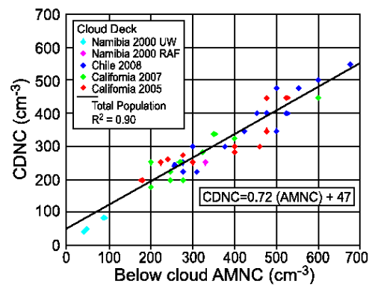
Entrainement dans les StratoCu d’aérosols dans la couche limite
Effet radiatif semi-direct → augmente LWP
Formation de gouttelettes
Johnson et al. (2004)
Hegg et al. (2012)

Slide 14
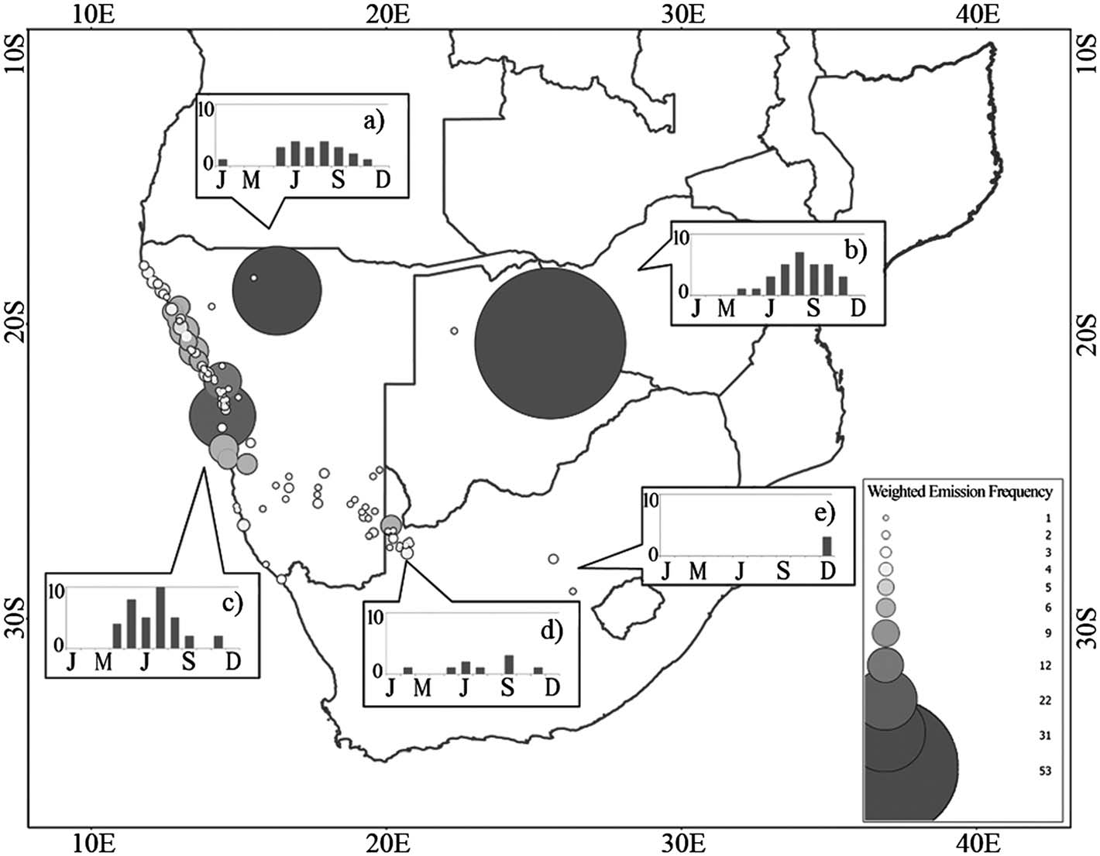
Sources de poussières terrigènes en Afrique australe
Vickery et al., 2013

Slide 15
Activités en cours
Etude des propriétés physico-chimiques et optiques des aérosols transportés ou émis en Namibie

Slide 16
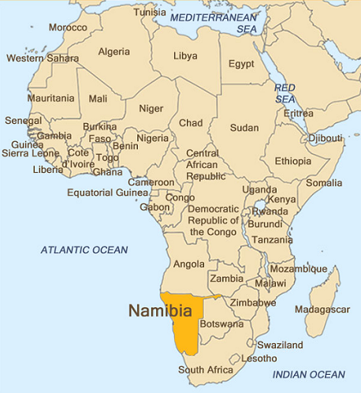






Observations à long-terme des propriétés des aérosols atmosphériques
GDRI ARSAIO (Atmospheric Research in Southern Africa and the Indian Ocean), CNRS/NRF (2011-2017)
PHC PROTEA (2015-2016)
Henties Bay (22°6’S, 14°30’E)
Gobabeb (23°7’S, 15°1’E)
16

Slide 17
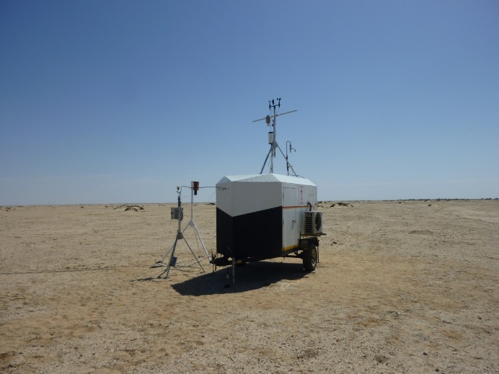
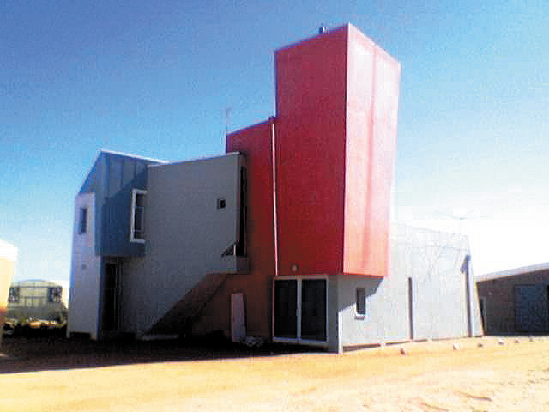
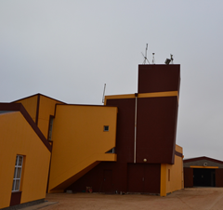
2011
2012
2013
2014
2015
Construction works
Second intensive campaign (filter sampling)
Sunphotomer
Neph
Partisol
Start continuos surface observations
First intensive campaign (filter sampling)
Sunphotomer @ Gobabeb
Sunphotomer observations
San Nujoma Marine & Coastal Resources Research Centre (SANUMARC), Henties Bay
2011
2012
2015

Slide 18
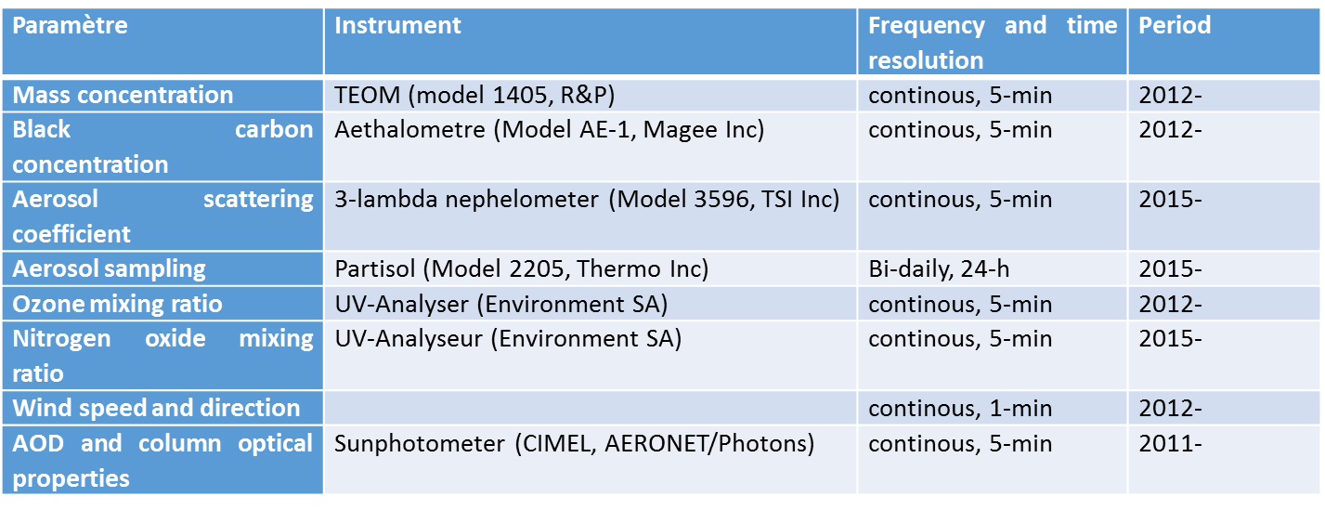
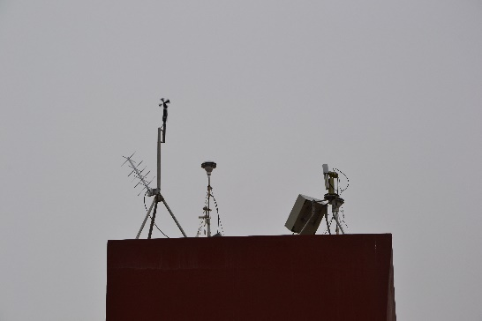
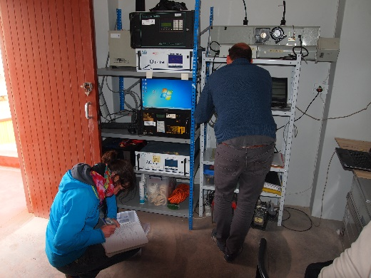
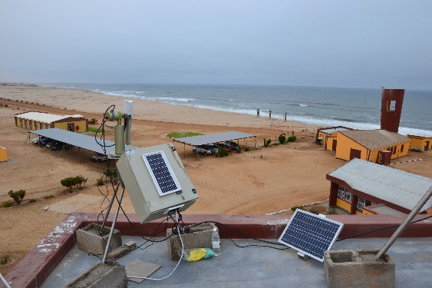
Instrumentation

Slide 19
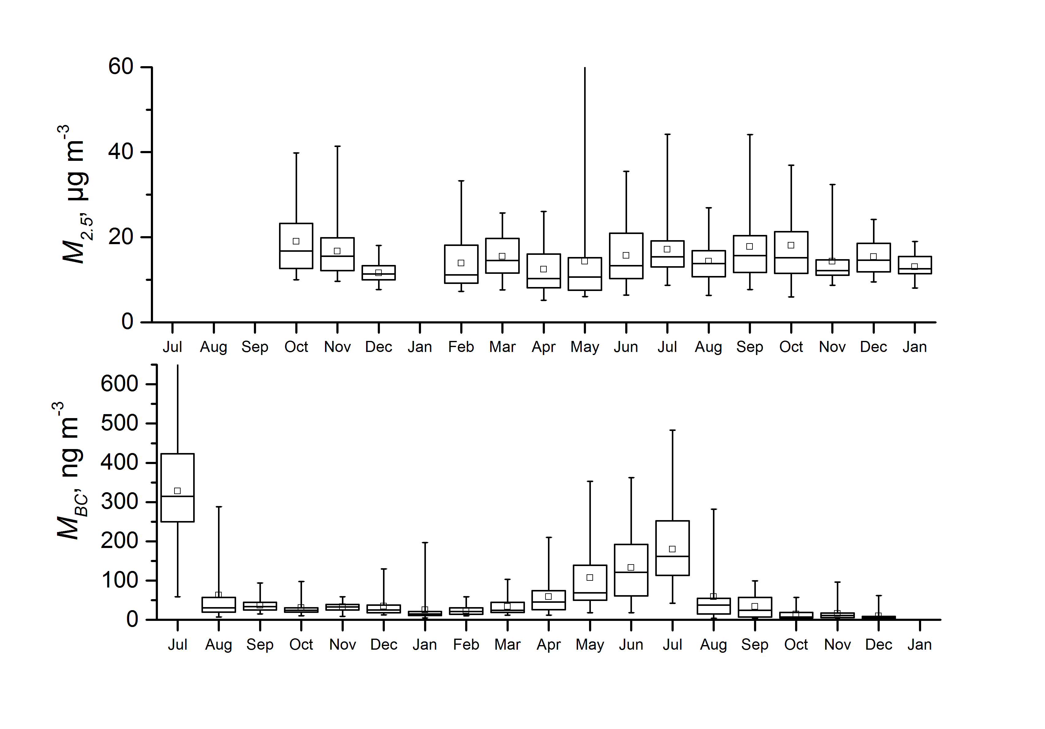
2012-2013
Formenti et al., submitted

Slide 20
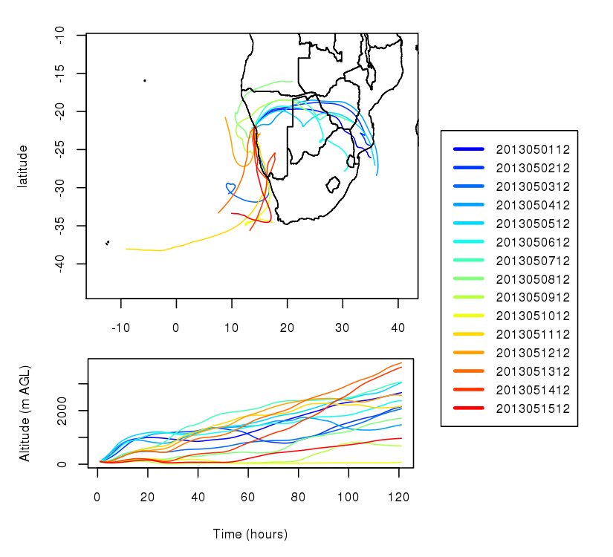
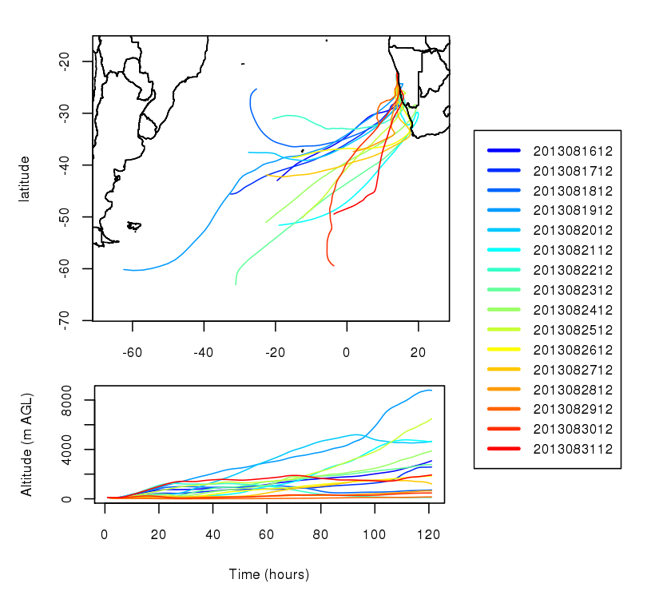
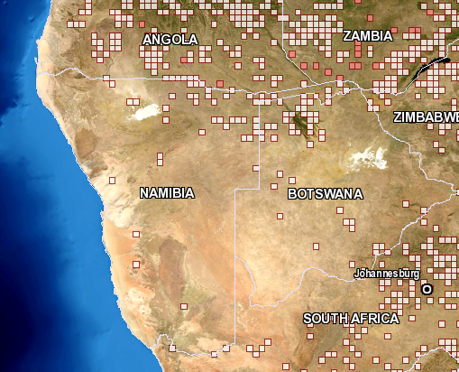
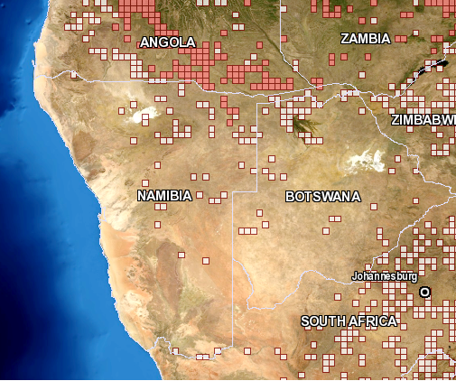
Formenti et al., submitted

Slide 21
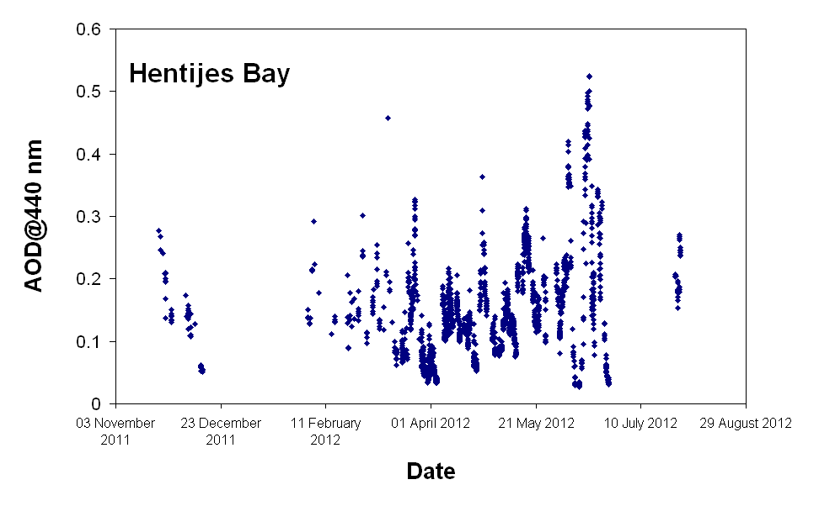
Limited temporal coverage because of persistent cloudiness and instrument failure
No clear seasonal cycle
AOD increase towards the wintertime
AOD Same order of magnitude than close to BB&dust source regions

Slide 22
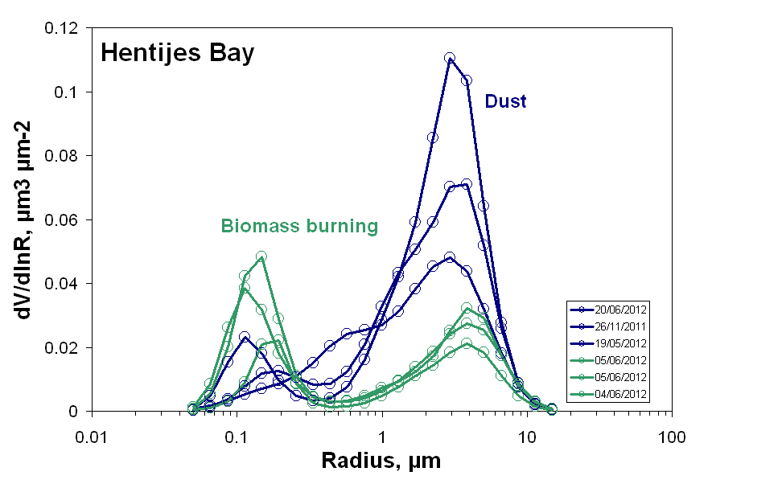
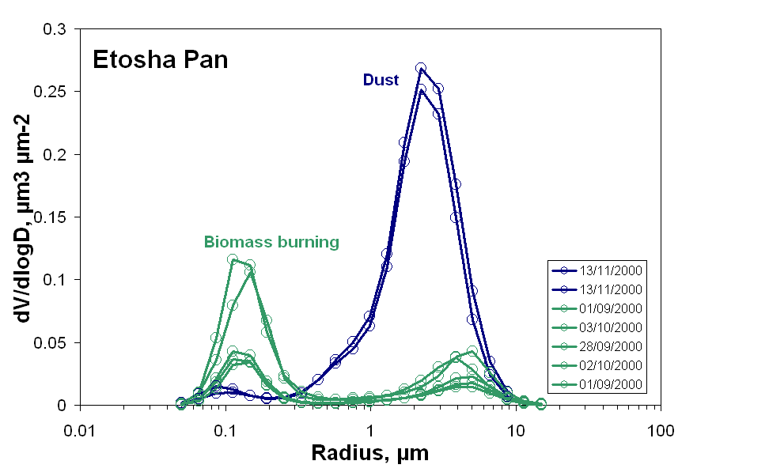
Volume size distribution

Slide 23
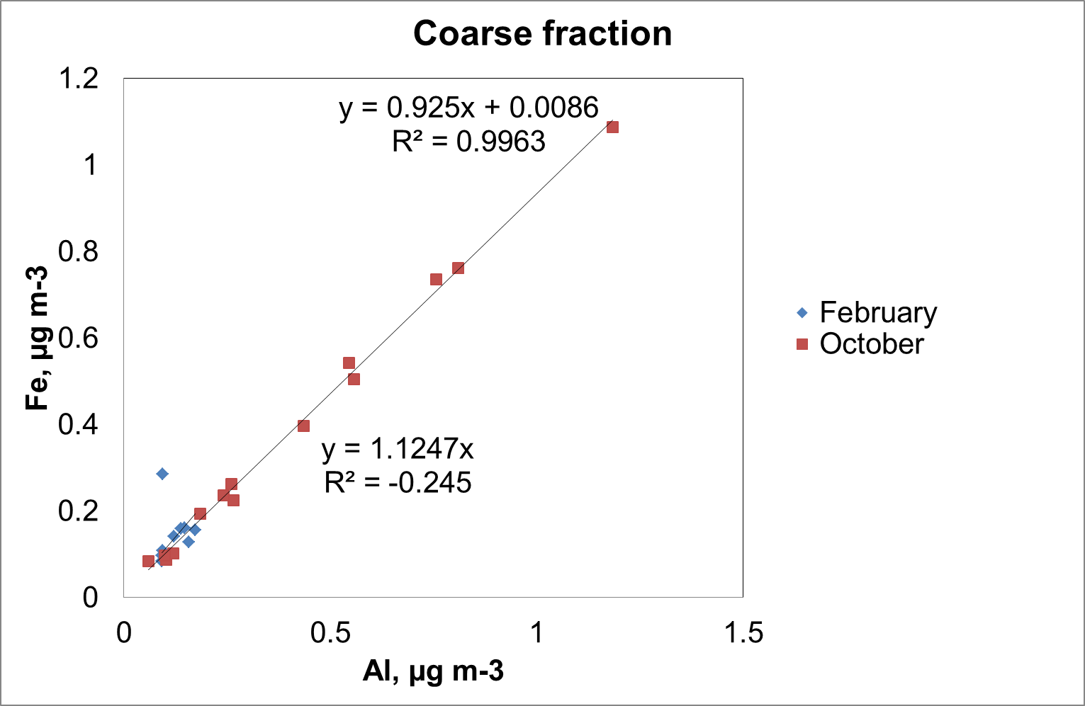
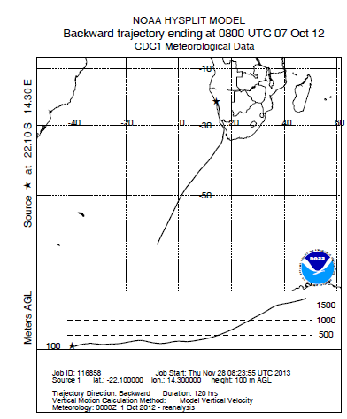
Dust transport episode: 7-9 October 2012
Enrichissement en Fe

Slide 24
Activités prévues

Slide 25
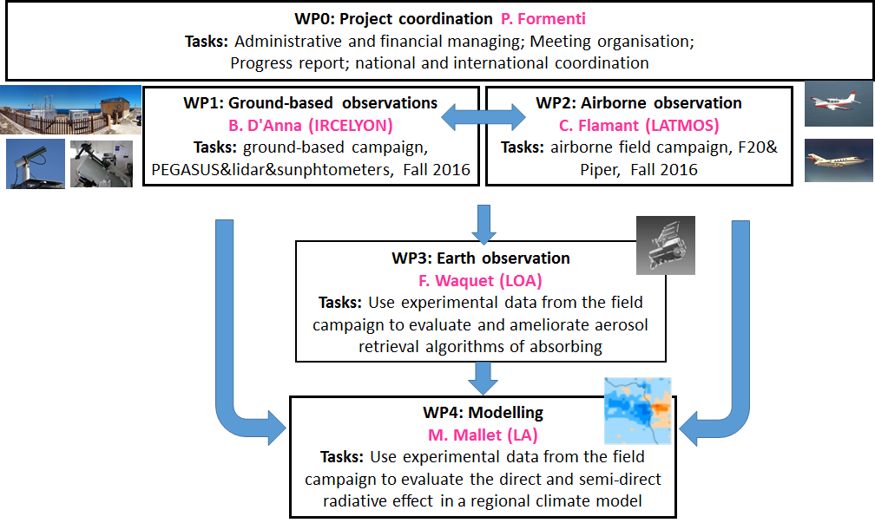




Le projet AEROCLO-SA: Aerosols, clouds, and radiation in Southern Africa

Slide 26
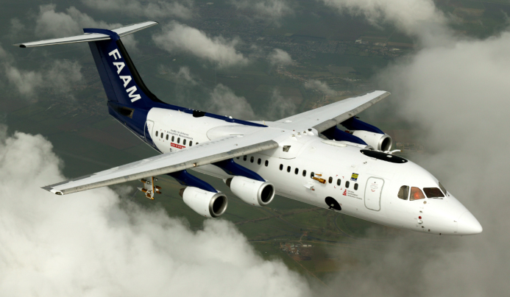
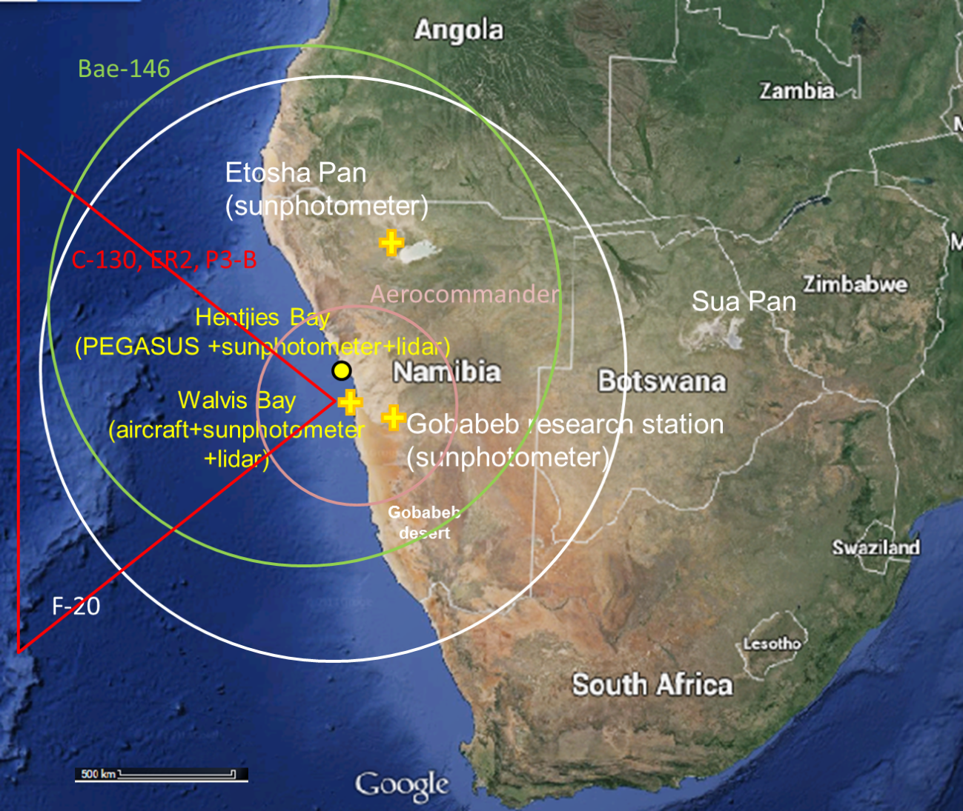
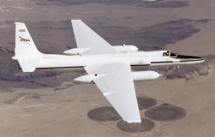
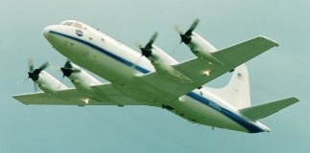
Le cadre internationale: le consortium COLA (CLARIFY-2016-ORACLES-LASIC-AEROCLO)
Campagnes intensives en Sept 2016
UK BAe-146: in situ
NASA ER-2: télédétection
NASA P-3: télédétection

Slide 27

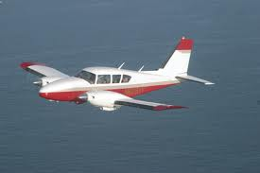
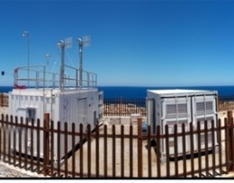
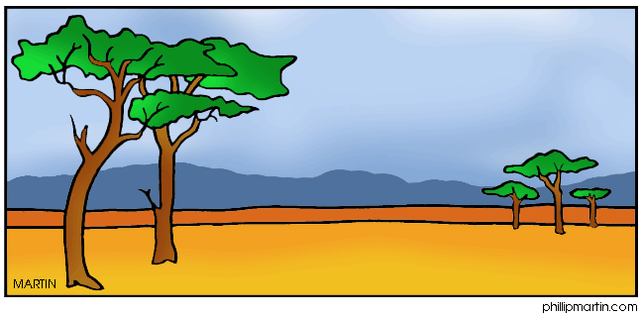
Observations intensives
F-F20 (OSIRIS)
BB
Nuages
Stratocumulus
Entrainement
Dust
Lidars
Sunphotometer
PEGASUS
Fires

Slide 28
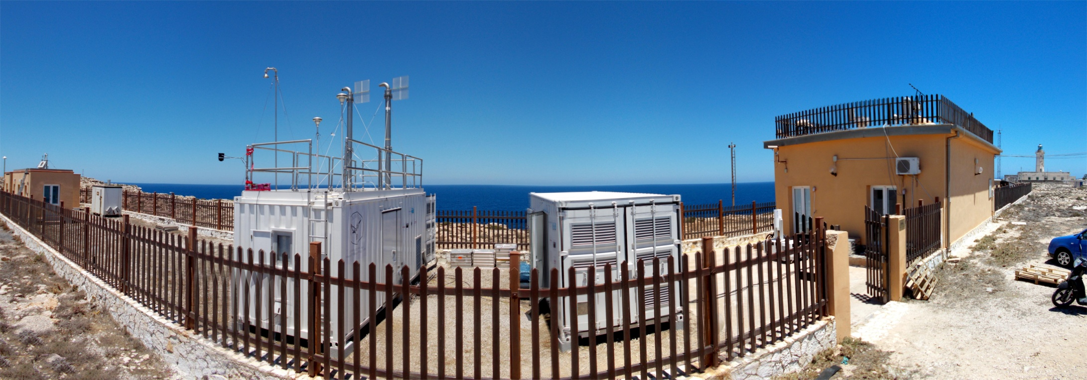

Les observations au sol
PEGASUS
Observatory
PEGASUS
Laboratory
ChArMex – Lampedusa (Italie), été 2013

Slide 29
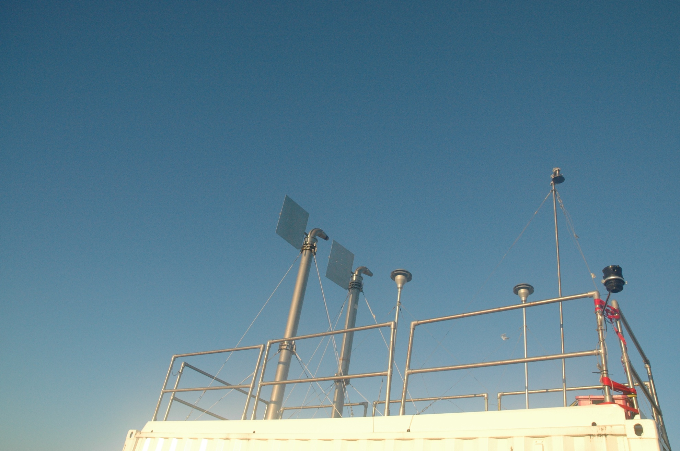
PEGASUS: aerosol and gas inlets
Gaz sampling line
LISA wind-orientable
HI-VOL aerosol inlets (PM40)
Certified aerosol inlets (TSP)

Slide 30
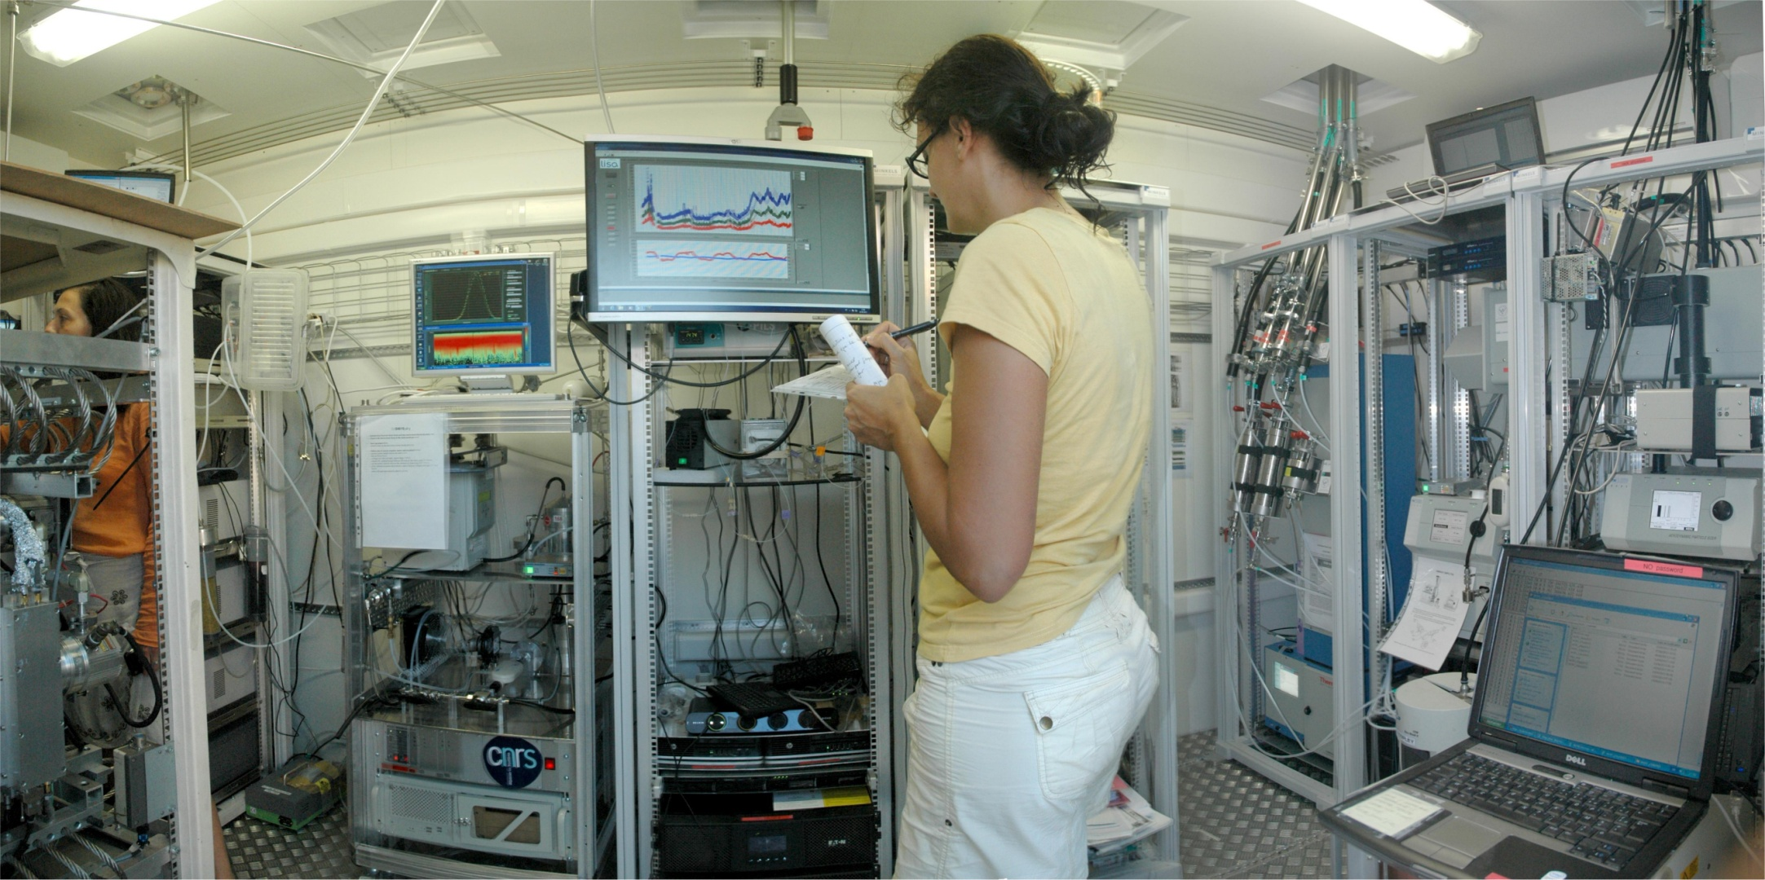
Gaz sampling line
Aerosol TSP inlet
Aerosol LISA HI-VOL inlets

Slide 31
Aerosols: in situ
Parameter | Instrument | Scientific Objectives
Mass concentration | TEOM microbalance (Thermo) | Aerosol concentration
Number concentration | Condensation Particle Counter | Aerosol concentration
Inorganic fraction | Filter sampling + XRF, DRX, IC analysis | Aerosol composition
Black carbon fraction | Filter sampling + thermo-optical analysis | Aerosol composition
Organic fraction | Filter sampling + thermo-optical, SFE analysis | Aerosol composition
Particle composition | Filter sampling + electron microscopy analysis | Aerosol mixing state
Size-segregated aerosol composition (inorganic/organic) | Impactor sampling + XRF/IC/thermo-optical analysis | Aerosol composition and mixing state
Online submicron composition | Aerosol mass spectrometer | Aerosol composition and mixing state
Online ionic soluble fraction | PILS | Aerosol composition and mixing state
Particle size distribution (10 < D < 500 nm) | Scanning Mobility Particle Sizer (TSI) | Aerosol physical properties
Particle size distribution (250 nm < D < 30 µm) | Optical particle counter (GRIMM ) | Aerosol physical properties
Particle size distribution (500 nm < D < 20 µm) | Aerodynamic Particle Sizer (TSI) | Aerosol physical properties
Spectral scattering coefficient (K_{scat} at 440, 550, 670 nm) | Nephelometer (TSI) | Aerosol optical properties
Spectral absorption coefficient (K_{abs} at 370, 420, 470, 590, 660, 880, 950 mn) | Aethalometer (Magee)/MAAP | Aerosol optical properties
Particle extinction coefficient (K_{ext} at 450 and 660 nm) | CAPS PMEx (Aerodyne) | Aerosol optical properties
Particle Hygroscopicity | HTDMA (Home-made from TSI SMPSs) | Aerosol micro-physical properties
Particle morphology | Filter sampling + MET/MEB/MEBE microscopy analysis | Aerosol micro-physical properties

Slide 32
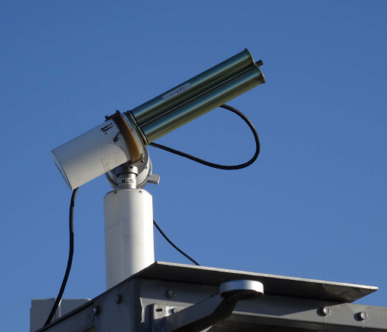
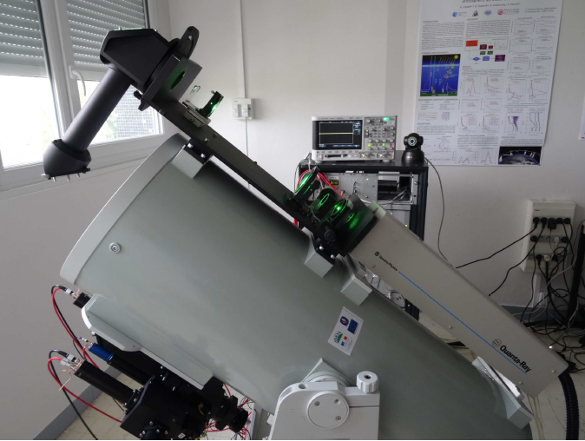
Lidars/photomètres
Pressure, temperature, humidity, wind speed, wind direction | CIMEL Met station | Physical param.
Aerosol vertical distribution | LIDAR (Leosphere ALS300) | Physical param.
Irradiance / actinic flux | LiCOR LI180 + shadowband | Physical param.
Photomètres (PHOTONS)
Lidars
LISA + PHOTONS
LISA + LOA

Slide 33
Gaz phase
SO₂ concentration | Gaz analyser (APSA, Horiba) | Gas phase characterization.
O₃ concentration | Gaz analyser (APOA, Horiba) | Gas phase characterization
NO_{x} concentration | Gaz analyser (APNA, Horiba) | Gas phase characterization
CO/CO₂ concentration | Gaz analyser (Picarro) | Gas phase characterization
VOC concentration | high resolution PTR-ToF-MS (Kore ltd) | Gas phase characterization

Slide 34
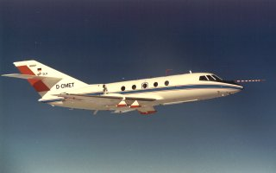
Airborne observations
F20/SAFIRE
Piper Aztec
OSIRIS (POLDER/3MI simulator)
HR-LNG lidar (532 and 1064 nm)
Micropol, Minimir, CLIMAT
PLASMA active tracking sunphotometer

Slide 35
Retrieval of absorbing aerosols above clouds & dust aerosol 3D distribution
POLDER/PARASOL
IASI
Peers et al.,2015
Cuesta et al., 2015
Synergie nouvelle
Notes:
the estimation of the COT that takes into the aerosol absorption gives
higher values than the MODIS MYD06 cloud product. Because aerosols absorb at the
wavelengths traditionally use to retrieve the COT, the cloud appears darker leading to
an underestimation of its optical thickness. The bias increases with the aerosol ab-
sorption and the COT due to the logarithmic relation curve between radiances and with
COT. Where the clouds are the thickest and the absorption ACAOT the largest (i.e., a small area around (10
◦S, 8◦E)), the bias is around 15. On average over the whole
scene, ACCOT is larger than the MODIS value by 1.2

Slide 36
Modelling: RCM (RegCM) - “on-line” mineral dust and biomass burning aerosol schemes
Direct et semi-direct effects
  Can we simulate the changes (↓) in entrainment rate at the cloud top → humidification effect
  Can we reproduce the increase in LWP (↑ 20 g.m-2) during smoke events compared to clean atmosphere
  Quantify the impact on SST
  Perform simulations at the climatic decadal time-scale
  In a second time, RegCM will serve to evaluate whether the inclusion of aerosol radiative perturbations improves the observed SST bias over the region.

Slide 37
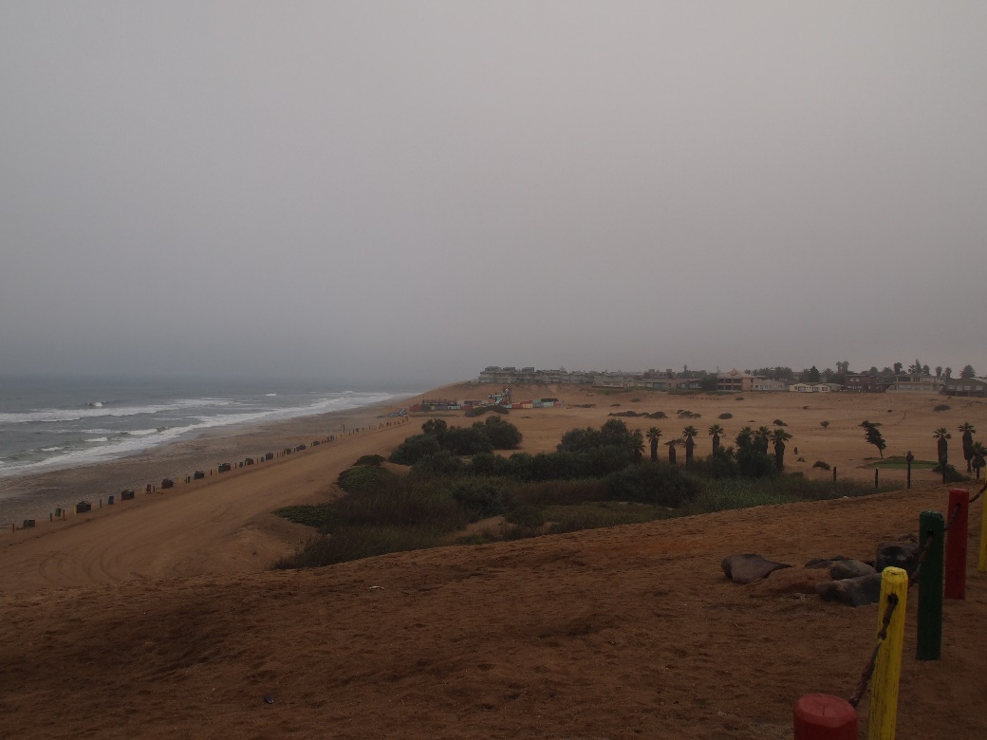
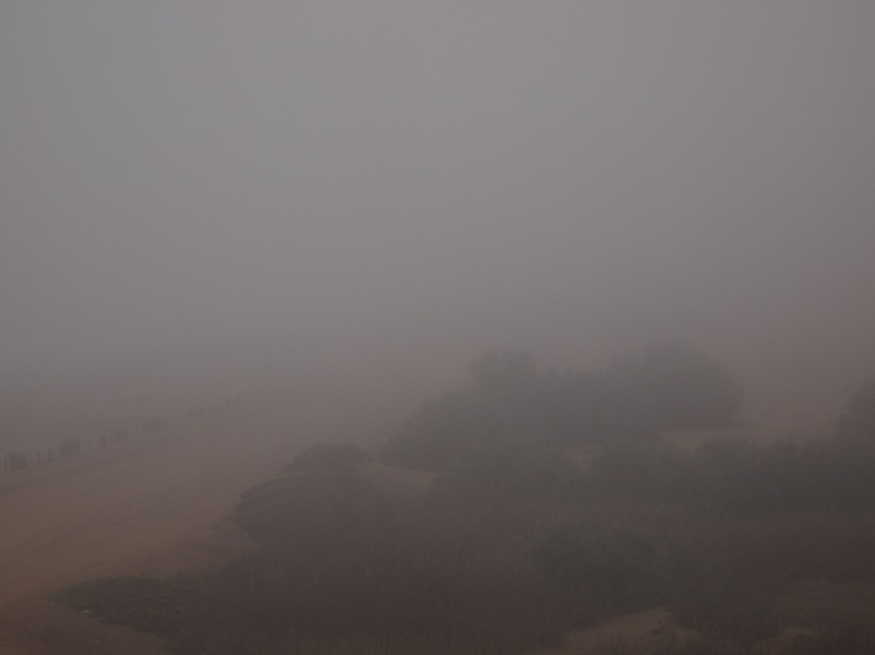
MERCI
25/04/2015
26/04/2015

Slide 38
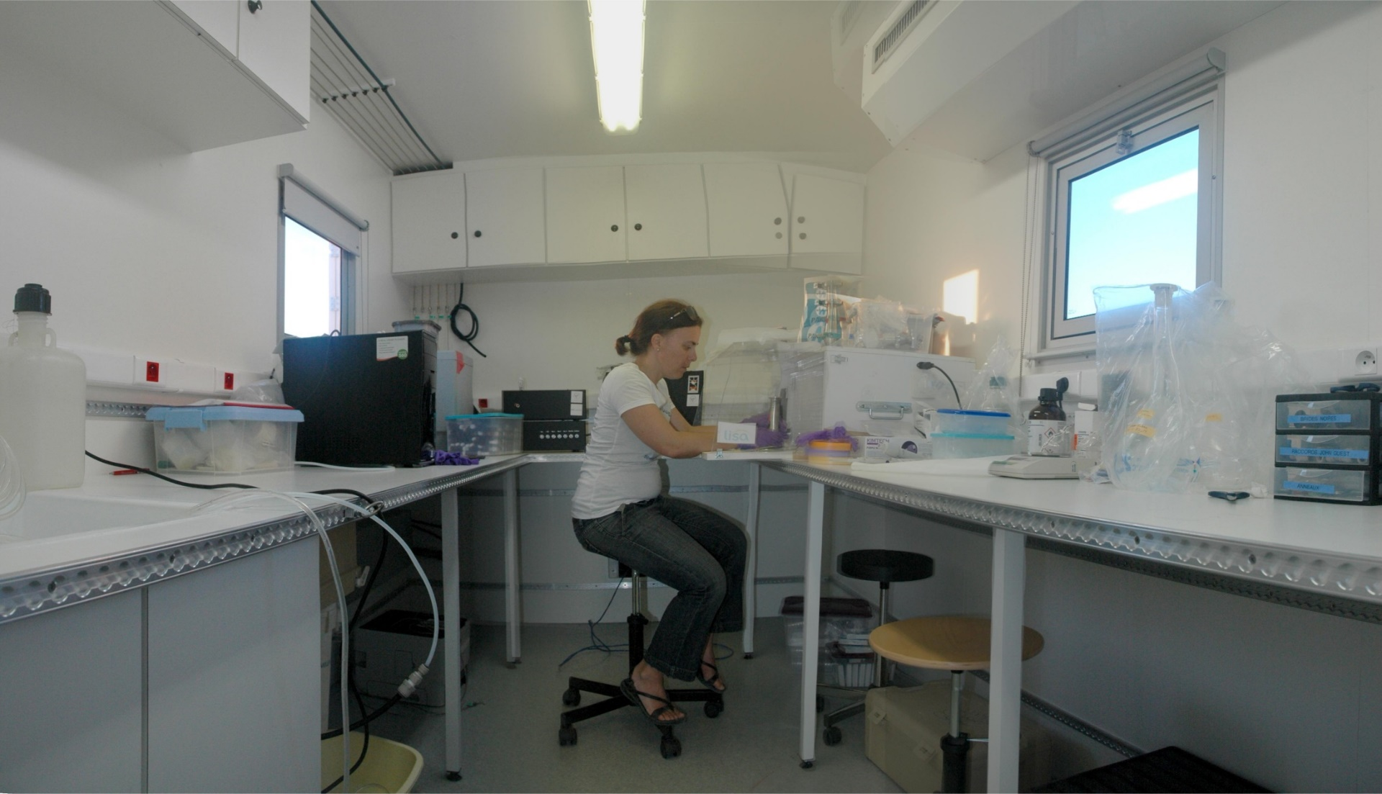
Mobile laboratory
Sample preparation and storage
Real-time analysis (sunset analyser for EC/OC, XRF for elemental composition)

Slide 39
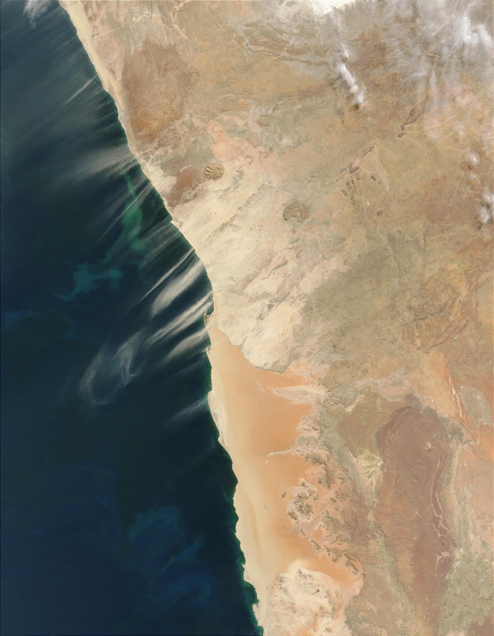
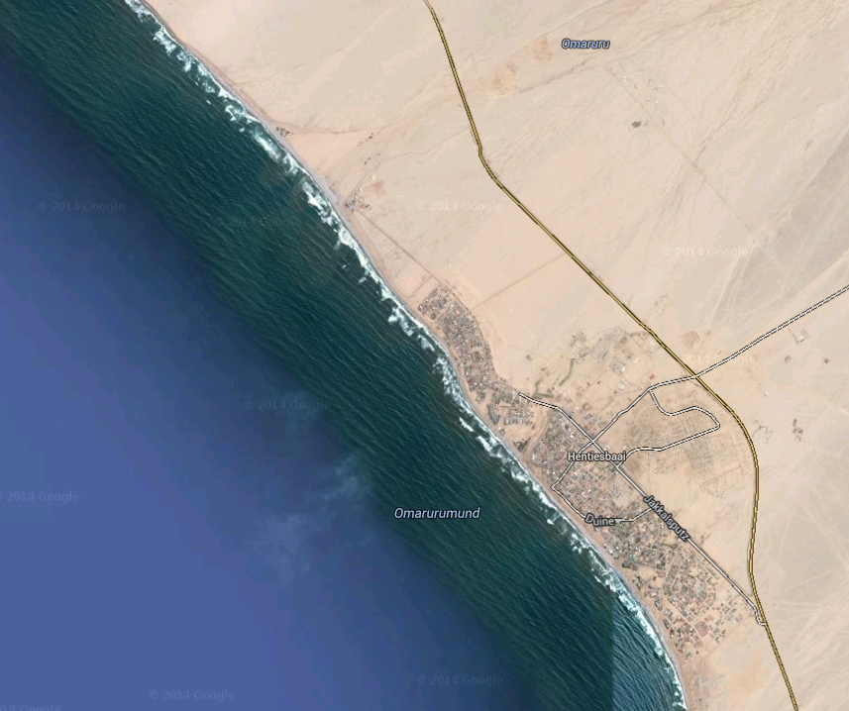
University
Hentijes Bay
Walvis Bay
(aeroport)
Hentijes Bay
Namib Desert
Research facility of the University of Namibia
Atlantic Ocean

Slide 40
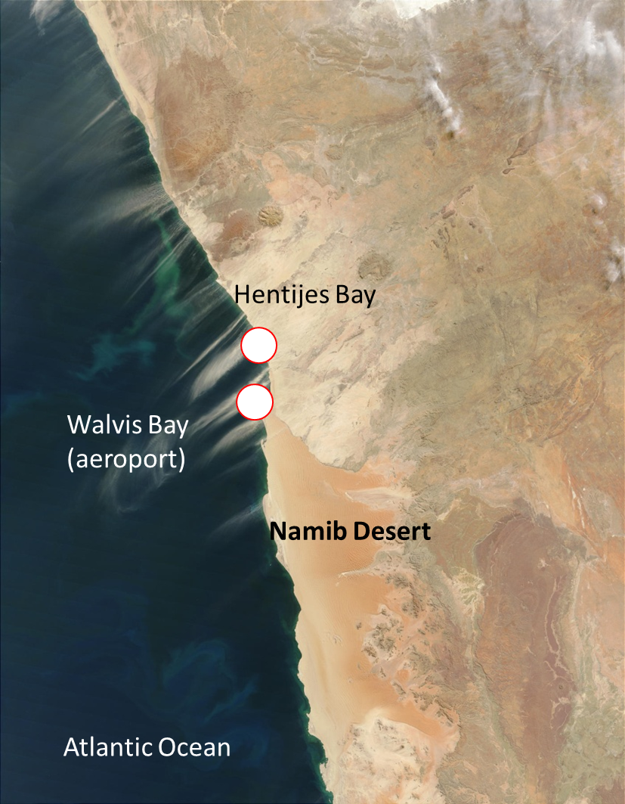


Ground-based measurments at San Nujoma Marine & Coastal Resources Research Centre (SANUMARC) at Henties Bay (22.09°S, 14.26°E)
Gobabeb

Slide 41

Instrumentation (1/2)

Slide 42
Instrumentation (2/2)

Slide 43

MWAA : Multi-Wavelength Absorbance Analyzer
Stepper motors:
filter selection
and scanning
16 positions
Filter wheel
Motorized Stage
Diode lasers
375 nm
407 nm
532 nm
635 nm
850 nm
PD:
165°
PD:
Transmitted light
PD:
125°
Massabò et al., 2013; 2015

Slide 44

Absorption behaviour: Ångström Exponent
Massabò et al., 2015

Slide 45

StratoCu
Brouillard
Persistent
Quasi-daily

Slide 46
Retrieval of dust aerosol 3D distribution
IASI
Cuesta et al.,
2015

Slide 47

Effet radiatif direct des aérosols amplifié quand ils se trouvent au dessus des nuages
Z (km)
3
TOA
Moyenne journalière
2
1
6
3
1
Couche nuageuse
ñ = 1.5 – 0.006i à 500 nm
C = 100 mg m⁻²
Diamètre moyen (distribution en masse) = 3.5 µm (sigma 2)
Liao and Seinfeld, 1998
Notes:
In the presenceo f a cloud layer, TOA warming is
strongestw hen the dust layer lies above the cloud layer (Figure
2), sincet he dust absorbsb oth incomings olar radiationa nd that
reflected by the cloud layer [Crisp, 1997; Haywood and Shine,
1997; Hansen et al., 1997].
With 50% of total column burden located above cloud, TOA
forcingo f a dustla yera t 0-3k mi s abou2t W m- 2l argetrh ant hat
of a dustla yera t 0-1 km anda bou1t .5 W m- 2l owert hant hato f
a dust layer at 3-6 km. The three lines for TOA forcing tend to
convergweh ens urfacael bedois high( rs > 0.6)b ecausteh eh ighalbedo
surface leads to more absorption of radiation by aerosols
below the cloud layer. When the dust layer lies completely
beneathc loud, TOA shortwavefo rcing changess ign as rs
increases, being negative over low-albedo surfaces and positive
over high-albedos urfaces.
Surface shortwave forcing under cloudy sky conditions is not
so sensitive to the altitude of the dust layer as TOA shortwave
forcinge, specialloy verl ow-albedsou rface(sr s<0.3). Surfaces
with highera lbedo(r s> 0.3) leadt o strongemr ultiples cattering
among surface, cloud and dust aerosol, as well as more
absorptiona long the opticalp ath. When the dust layer is located
below the cloud layer (0-1 km), multiple scatteringp roducesth e
strongesct oolingf or high-albedos urfaces.

Slide 48
Apport de la télédétection à la restitution des propriétés des aérosols au-dessus des nuages
Données POLDER/PARASOL
Couche d’aérosol issus de feux de biomasse à 3 km et sommet des nuages à 1 km
Petites particules
Fortement absorbantes
Effet radiatif intense (positif)
Peers et al.,
2014
Notes:
the estimation of the COT that takes into the aerosol absorption gives
higher values than the MODIS MYD06 cloud product. Because aerosols absorb at the
wavelengths traditionally use to retrieve the COT, the cloud appears darker leading to
an underestimation of its optical thickness. The bias increases with the aerosol ab-
sorption and the COT due to the logarithmic relation curve between radiances and with
COT. Where the clouds are the thickest and the absorption ACAOT the largest (i.e., a small area around (10
◦S, 8◦E)), the bias is around 15. On average over the whole
scene, ACCOT is larger than the MODIS value by 1.2

Slide 49
…et des nuages au-dessous des aérosols
Données POLDER/PARASOL
Biais systématique entre capteurs (ex. POLDER/PARASOL vs MODIS MYD06 ) lié à la non prise en compte des propriétés d’absorption des aérosols par les algorithmes d’inversion
Peers et al., ACPD, 2014
Notes:
the estimation of the COT that takes into the aerosol absorption gives
higher values than the MODIS MYD06 cloud product. Because aerosols absorb at the
wavelengths traditionally use to retrieve the COT, the cloud appears darker leading to
an underestimation of its optical thickness. The bias increases with the aerosol ab-
sorption and the COT due to the logarithmic relation curve between radiances and with
COT. Where the clouds are the thickest and the absorption ACAOT the largest (i.e., a small area around (10
◦S, 8◦E)), the bias is around 15. On average over the whole
scene, ACCOT is larger than the MODIS value by 1.2

Slide 50


Hentjies bay station
Hentijes Bay
Namib Desert
Research facility of the University of Namibia
Atlantic Ocean

